Slide 1
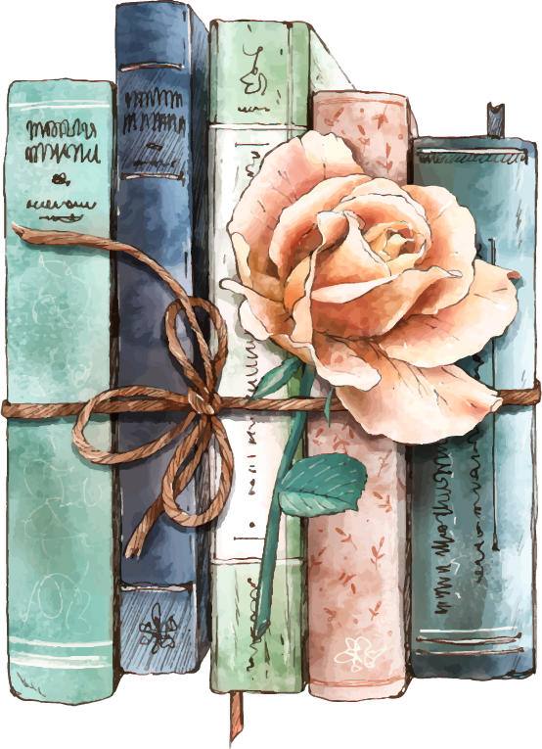
Things Not Said Aloud: American Female Confessional Poetry Tradition
Presented by Emily Wheeler
Notes:
Handout of poems? Dr. C printouts?

Slide 2
Capstone Overview
01
02
Poet Research
Wrote/Compiled Poems
03
04
Pursuit of Publication
Analytical Essay
Inspiration from and Literary Criticism about: Dickinson, Plath, Sexton, H.D., Rich
Wrote new poems biweekly and edited into a poetry collection
Submitted to several chapbook and book contests and gained experience
Drew connections between poet’s work and my own
Notes:
Transformation/growth with flowers and book cover

Slide 3
Doubleness and Transformation in American Female Confessional Poetry
Notes:
What is doubleness? What is transformation? What is American Female Confessional Poetry?

Slide 4
Doubleness
“They Shut Me Up in Prose”
“A Wedding March”
“It’s hard to live life at twenty-two/
when you are only twenty years old/… Twenty-two moments,/
since the second I was born,/
have prophesized this end/
for me.”
“They shut me up in Prose—/As when a little Girl/They put me in the Closet—/Because they liked me “still”—.”
Notes:
“They Shut Me Up in Prose” vs. “A Wedding March” double expectations

Slide 5
Transformation
“Lady Lazarus”
“Choosing the Wait”
“I have done it again. /
One year in every ten /
I manage it—/
…Out of the ash/
I rise with my red hair /
And I eat men like air.”
“…knowing that choosing the wait will break the frantic pace,/
the churning of a constantly changing mind/
and give me a chance to appreciate this good life as it happens./
… my laundry hangs on the clothesline behind us,/
fresh and clean as if brand new.”
Notes:
“Lady Lazarus” vs. “Fictional Adorations” and “Choosing the Wait”

Slide 6
Thank You.

