Slide 1
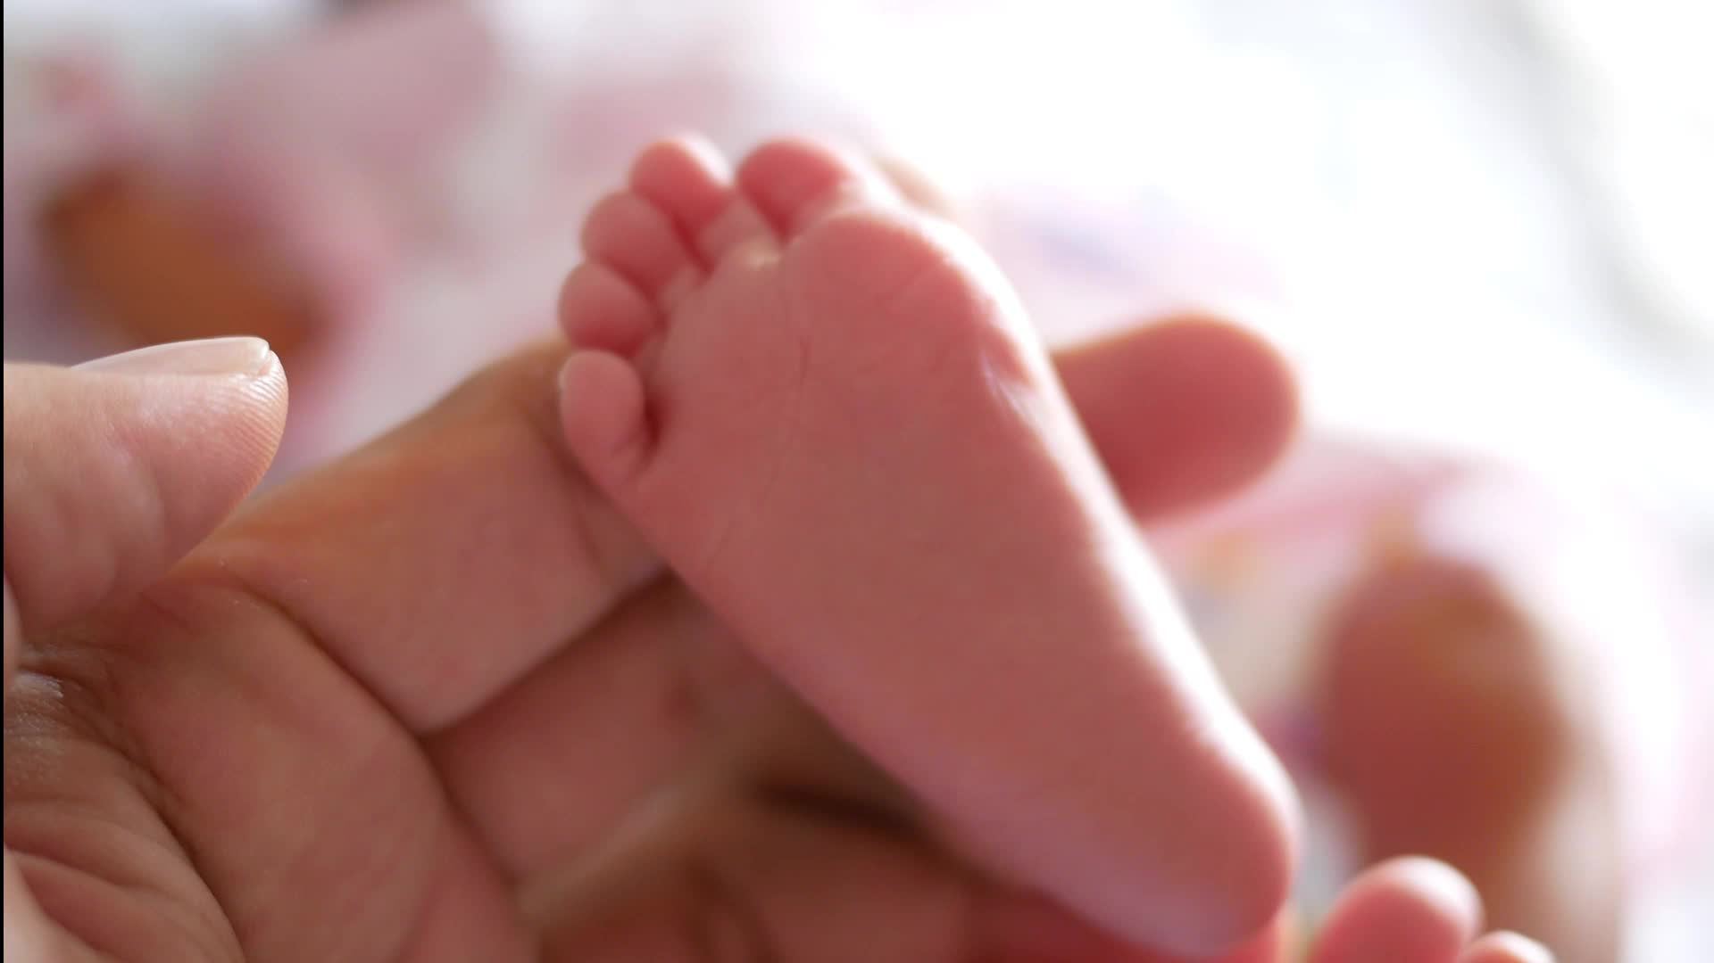
Effects of Infant Maternal and Sibling Separation in Rats
Shane McClafferty

Slide 2
Neonatal Intensive Care Units (NICU)
No mother
No contact comfort
Extended periods of time
Notes:
Infants are likely to be placed in a NICU for an extended time. Premature babies will spend most of their time here. This means spending time without a parent touching them and also without siblings. The goal of our research is to study the effect that this has on babies as they develop.

Slide 3
Human Research
Turney & Wildman (2016).
Foster children had more physical and mental problems.
Controlled for household conditions.

Slide 4
Previous Research on Maternal Separation in Rats
Kambali et al., (2019).
Increased spatial learning and attention
Decreased social interaction behavior
Jin et al., (2018).
Maternal separation
Early handling
Increased anxiety-like behavior
No Sibling separation
Notes:
Many studies have attempted to test the social and psychological effects of this treatment. These studies show that Maternal separation leads to decreased social interaction (in the Kambali et al. study) and increased anxiety (in the Jin et al. study). However, most animal studies also isolate the siblings together but separated from the mother, whereas humans do not usually have the opportunity be with siblings.

Slide 5
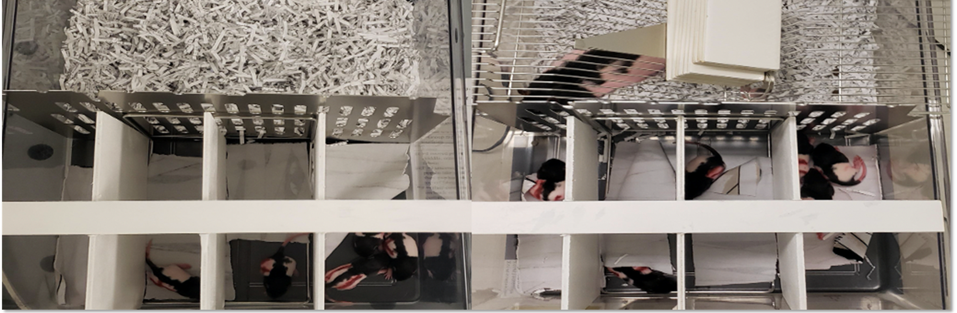
Rat Isolation
Mother or no mother nearby
Alone or grouped with siblings
Notes:
To see whether siblings have an effect we deploy a more unique separation method.
Mom and all her pups. We did multiple litters like this.
Half of her infant rat pups can see or hear her, but the other half cannot.
Pups can move from front to back

Slide 6
Experimental Design
Notes:
Each litter produced a pup for each of 8 groups for the study. An entire litter was randomly assigned to be separated from Mom for 180 min –the experimental group, OR 15 min – the control group. So with male and female pups, there was a total of 16 groups in the study.

Slide 7
Timeline by Postnatal Day (PND)
PND 1-14 Isolation
PND 22 Weaned and Group Housed
PND 48 Single Housed
PND 50 Elevated-Plus-Maze
PND 56 Open-Field Habituation
PND 57 Social Interaction
Notes:
Post-natal Day 0 was the day the pups were born.
They were weighed and marked on PND 1, and began the separation sessions immediately afterwards.
Puberty begins at about PND 35 and they are considered adolescents at PND 50 when they began the behavioral tasks.

Slide 8
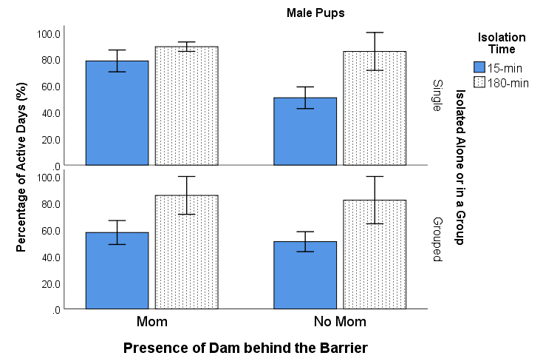
Isolation Activity
Percent of active days
Rats should be sleeping (nocturnal).
180-min rats were more active.
Notes:
This data is the percent of days (out of 14) during isolation sessions that they were active (wiggling, moving, walking, etc).
Explain every factor of the graph
Percent of Active days
Shows all sixteen group
Only experimental rats were more active

Slide 9
Timeline by Postnatal Day (PND)
PND 1-14 Isolation
PND 22 Weaned and Group Housed
PND 48 Single Housed
PND 50 Elevated-Plus-Maze
PND 56 Open-Field Habituation
PND 57 Social Interaction
Notes:
The rats were tested on the first behavioral task on PND 50.

Slide 10
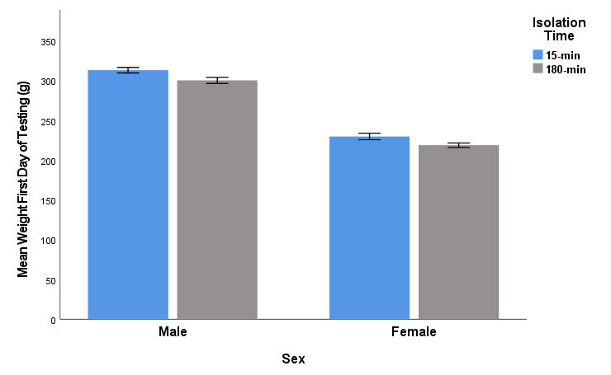
Body Weight on PND 50
Sex Differences
Differences in Isolation Time
Notes:
The male rats weighed more than the females (which is normal)
The 15-min rats (blue bars) weighed significantly more than the 180-min rats (gray bars), and this is over 5 weeks after the last isolation session.

Slide 11
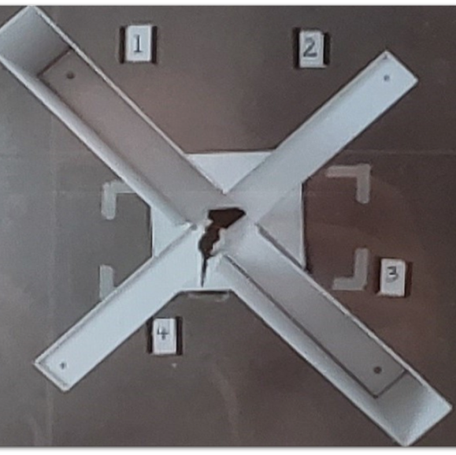
Elevated Plus Maze (EPM)
Closed Arms (Safe)
Open Arms (Danger)
Measures Anxiety
Notes:
Explain maze. Explain anxiety responses and non anxiety response.

Slide 12
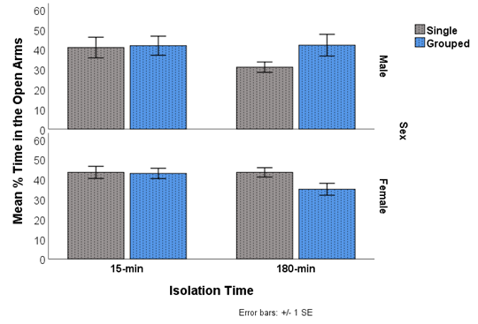
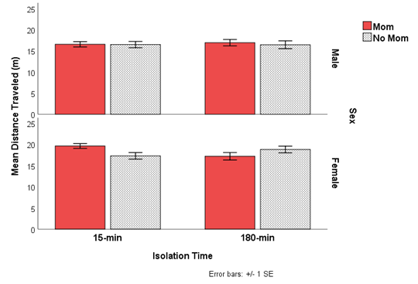
EPM Data
Male 180-min single rats - more anxious than single.
Female 180-min group rats - more anxious than grouped.
Female 15-min rats - more active with Mom.
Female 180-min rats - more active without Mom.
Anxiety/Open Arm Time
Activity/Distance Traveled
Notes:
The anxiety data is graphed on the left. There were no significant effects in the 15-min control animals. However, the …
Activity was measured by how far they traveled in the 5-min session. It is graphed on the right. There were no significant effects in the male groups. However, female rats were more active than males overall. In addition, the 15-min female rats….

Slide 13
Timeline by Postnatal Day (PND)
PND 1-14 Isolation
PND 22 Weaned and Group Housed
PND 48 Single Housed
PND 50 Elevated-Plus-Maze
PND 56 Open-Field Habituation
PND 57 Social Interaction
Notes:
The rats were tested on the next behavioral task beginning on PND 56.

Slide 14
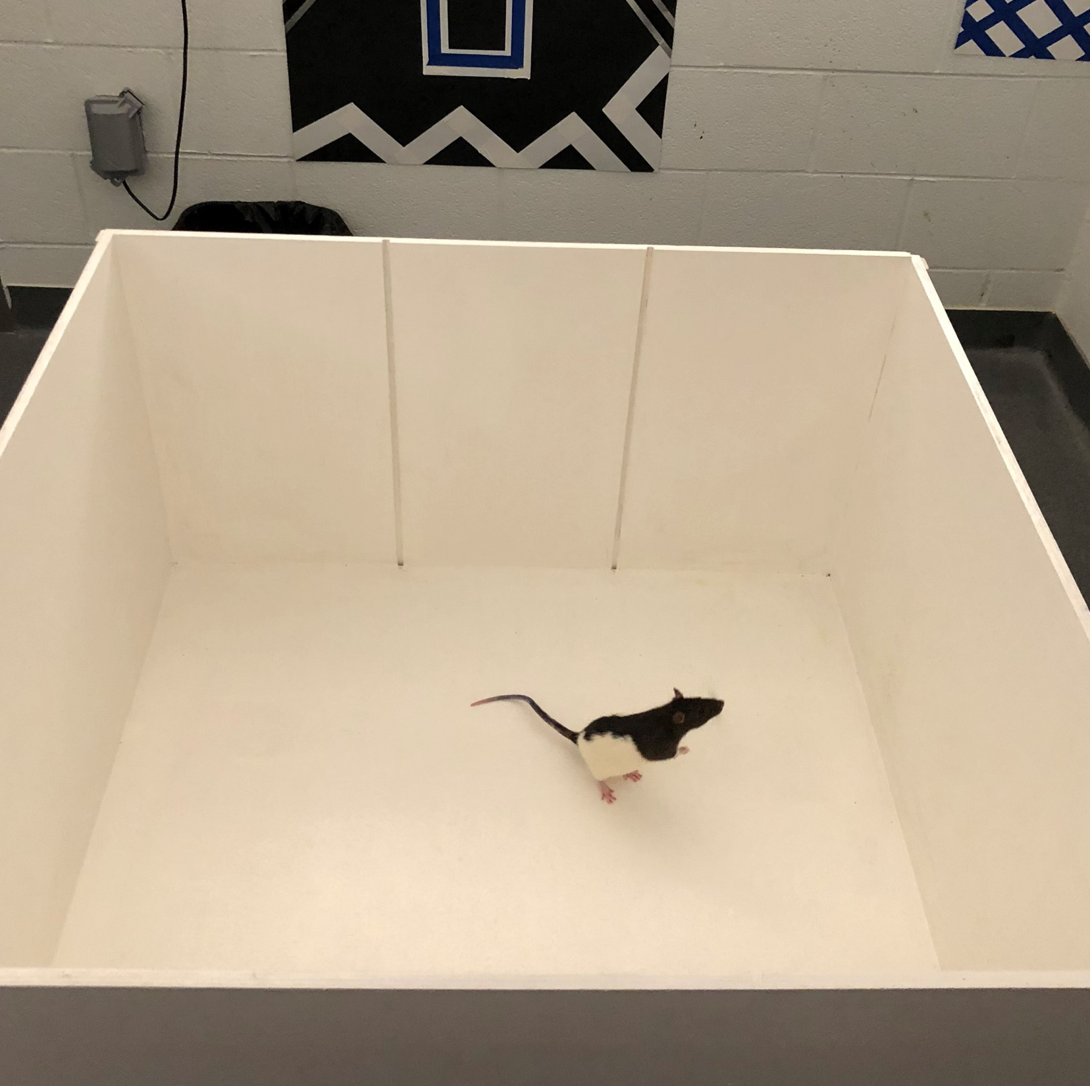
Open-Field Habituation (OF)
Near walls (Safe)
Center (Danger)
Measures Anxiety
Measures Activity
Notes:
Explain maze construction. Explain anxiety responses.

Slide 15
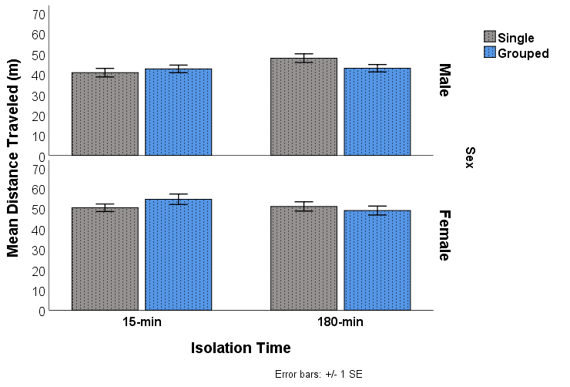
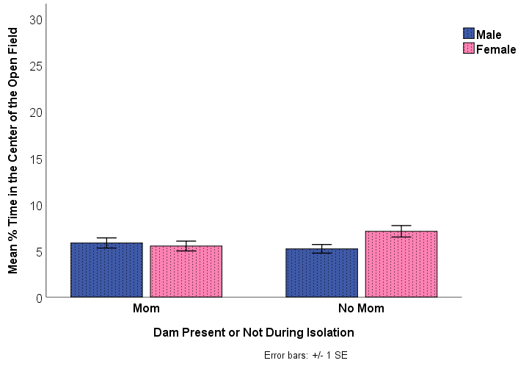
Open-Field
Females were more active than males.
All rats exhibited increased anxiety (floor effects).
Female rats isolated without mom were significantly less anxious.
Activity/Distance Traveled
Anxiety/Center Time
Notes:
Although the female rats were more active than the male rats (typical finding), the effect was larger in the 15-min control group. In addition, the Grouped animals overall (males and females) were more active in the 15-min control group, but less active in the 180-min experimental group.

Slide 16
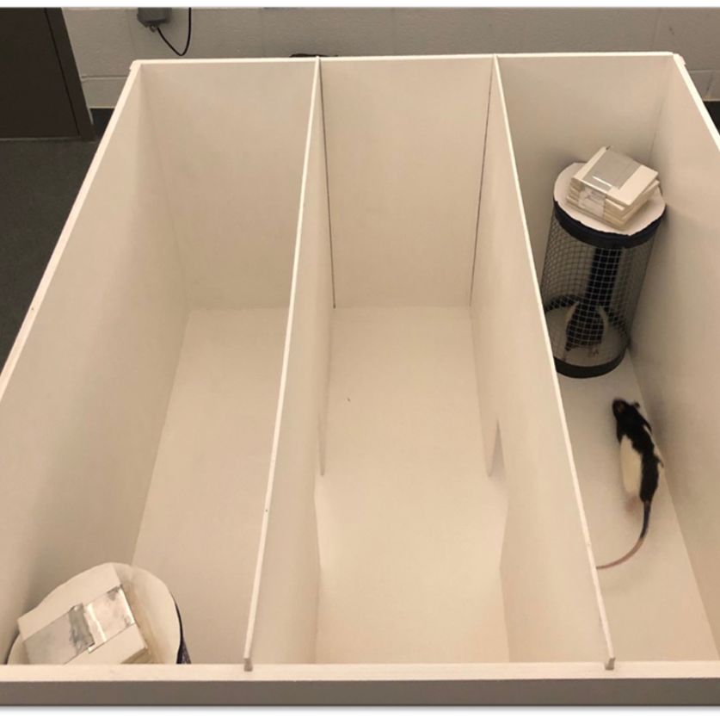
Social Interaction (SI)
Isolated for 9 days previously
Caged Rat
Empty Cage
Controlled for anxiety
Notes:
The rats were habituated to the apparatus and the room in the open-field.
Walls and two cages were added. One cage was empty and one cage contained a same-sex, similar-aged, but unfamiliar rat.
Explain maze orientation and the rats opportunity to socialize.

Slide 17
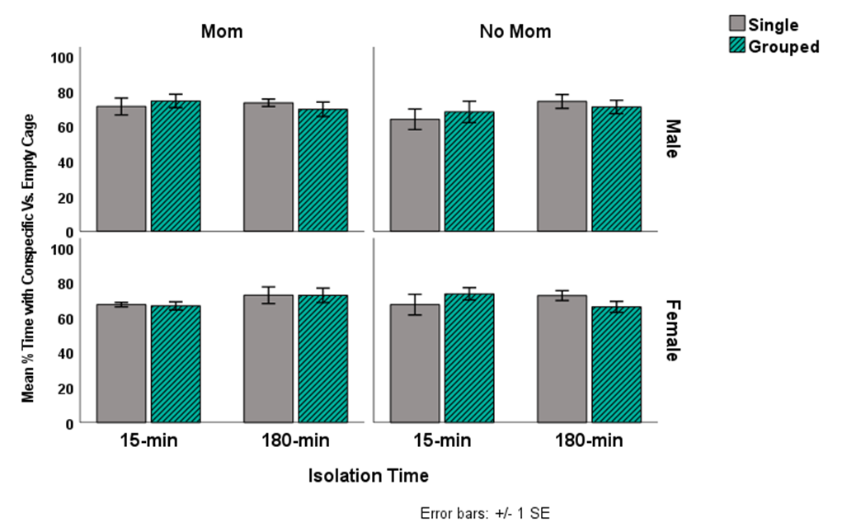
Social Interaction
Time with caged Rat Vs. Empty Cage
No significant effects
All rats spent more time with caged rat
No difference between groups
Notes:
Explain graph
Across the board spending more time

Slide 18
Discussion
Results on anxiety corroborate previous studies. Jin et al. (2018) found increased anxiety.
Results on social interaction did not corroborate previous studies. Kambali et al. (2019) found decrease social interaction after maternal separation.

Slide 19
Conclusion
Both sibling separation and maternal separation affect development.
However, the results are complicated by differences in sex.

Slide 20
References
Jin, S., Zhao, Y., Jiang, Y., Wang, Y., Li, C., Zhang, D., Lian, B., Du, Z., Sun, H., & Sun, L. (2018). Anxiety-like behaviour assessments of adolescent rats after repeated maternal separation during early life. NeuroReport, 29(8), 643–649. https://doi.org/10.1097/wnr.0000000000001010
Kambali, M. Y., Anshu, K., Kutty, B. M., Muddashetty, R. S., & Laxmi, T. R. (2019). Effect of early maternal separation stress on attention, spatial learning and social interaction behaviour. Experimental Brain Research, 237(8), 1993–2010. https://doi.org/10.1007/s00221-019-05567-2
Turney, K., & Wildeman, C. (2016). Mental and physical health of children in Foster Care. Pediatrics, 138(5). https://doi.org/10.1542/peds.2016-1118

Slide 21
Acknowledgements
A big thank-you to my fellow researchers:
Claudia Paniagua-Ugarte
Jacob Johnson
Zoe Hannabass
Laura Griffith
Sarahbeth Roberts
Autumn Buckler
Hope Davis
To the mentorship of Dr. Jackson.
The Honors College and Office of Undergraduate Research and Scholarship.
Notes:
Questions?

