Slide 1
The Fragments of Me
By: Kamaree (Kam) Ward

Slide 2
Overview of Capstone
A study of African American poetry from the Black Arts Movement to the present
Consisted of 7 original spoken word poems
Focused on elements of style from many black poets.
Researched on 4 different Black American poets
I dedicate this capstone to my mother.
Thank you to Dr. Sean Keck for the amazing mentorship!
This Photo by Unknown Author is licensed under CC BY

Slide 3
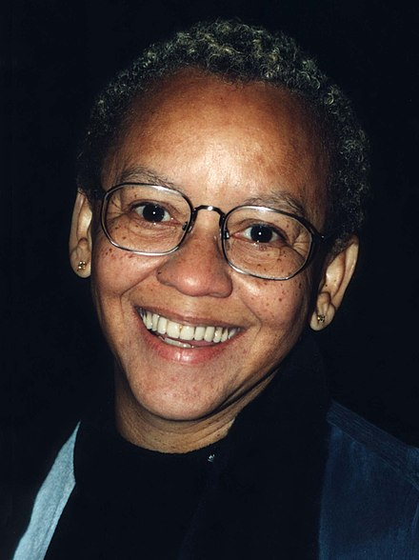
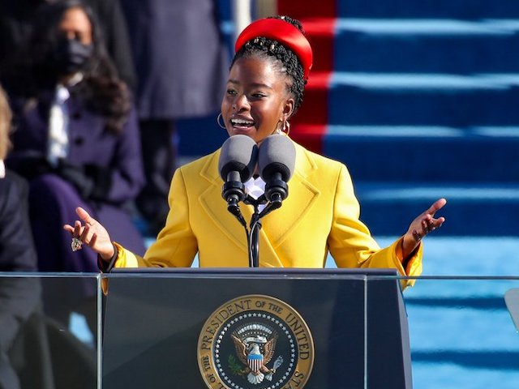
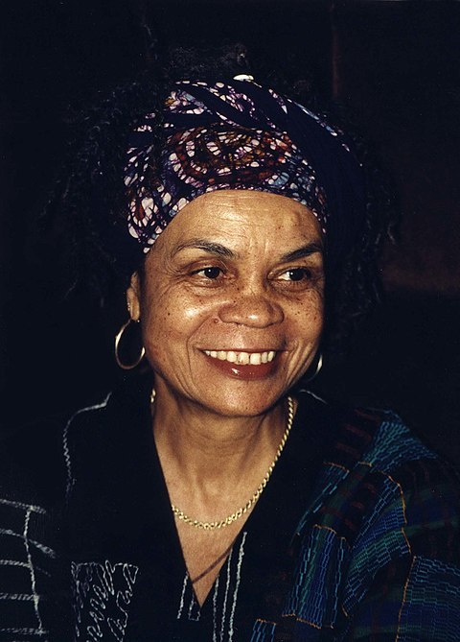
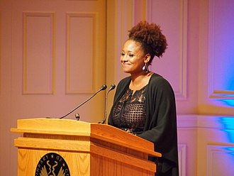
List of Specific Authors Studied
Amanda Gorman
Nikki Giovanni
Sonia Sanchez
Tracy K. Smith

Slide 4
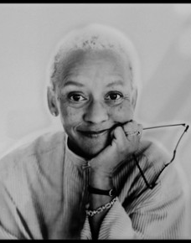
The Works of Nikki Giovanni
Nikki Giovanni focused on childhood moments in her poems.
Example: “Nikki-Rosa”
Elements that worked well:
Imagery
Theme of Love + Black Identity
Diction

Slide 5
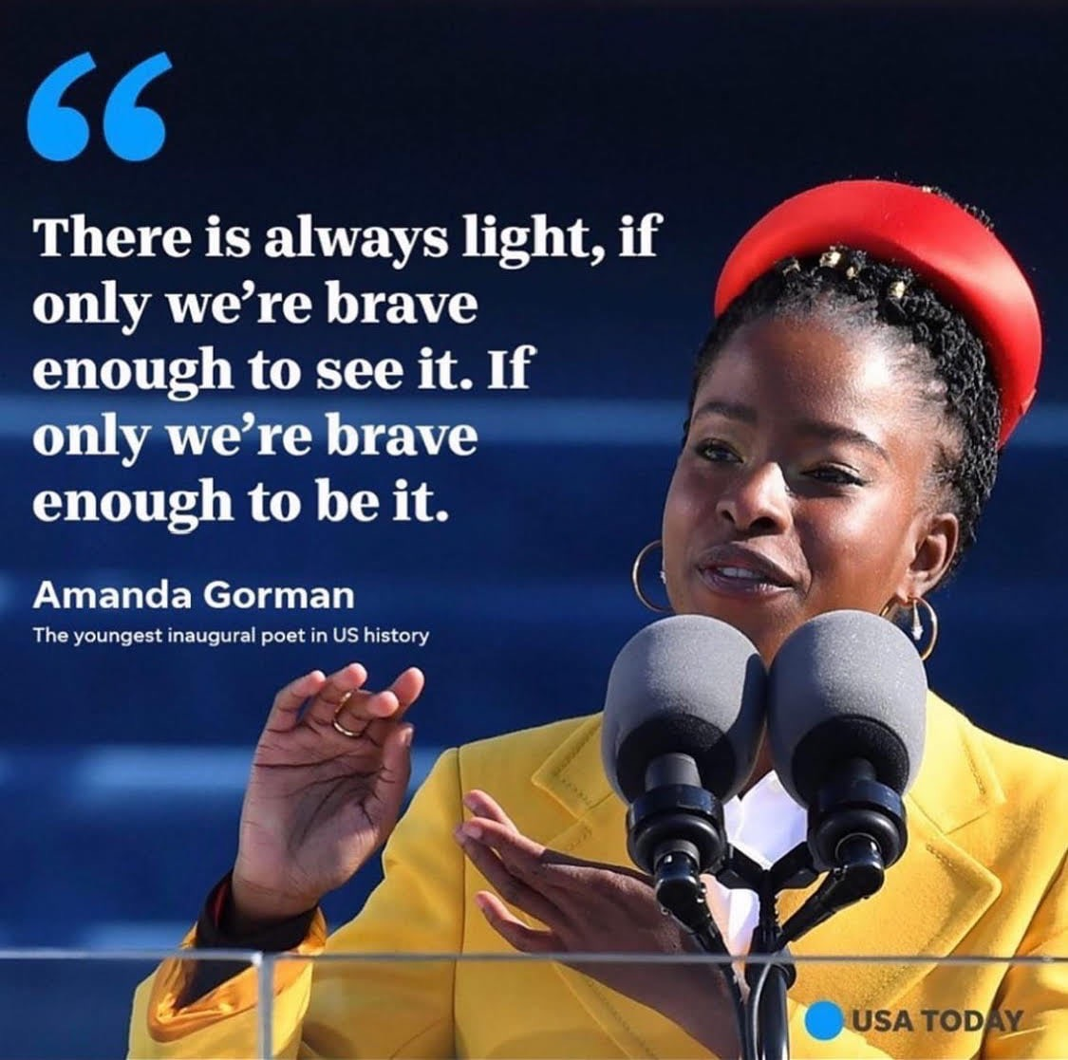
The Performance of Amanda Gorman
Gorman was researched to help my performance style when speaking my poems.
Amanda Gorman depicted the way she spoke certain words in her poems.
Speaking spoken word is powerful and words build emotions.
Example: Hand Gestures or Shouting

Slide 6
BROWN SKIN
Excellence lives within my brown skin.
My brown skin speaks
POWER over failure.
It creates anger and pain
as the tensions rises.
I am a guy who defies people’s eyes.
My brown skin defeats failure.
My brown skin shows bravery.
It holds the courage to uncover the truth.
It gives me power
to break through the barriers that hold me back.
It’s time for my skin to attack
the ones that do not show respect.
My brown skin hates racism.
My brown skin carries integrity.
It motivates my purpose within.
As my heart jumps for joy,
My brain builds stamina to win.
KNOWLEDGE is the answer to ignorance.
My brown skin exudes confidence.
It is rare to be like me.
I am the one who will fight thick and thin.
In the armor of my brown skin.

Slide 7
A Mother’s Love
Mom, I’m into guys!
Wait, hold up. What’s happening?!?
That’s the secret that frightens me.
Sweat drips down my face
getting goosebumps as I tell her.
Tears begin rushing down
my cheeks become rosy red.
Her face turns grave as she sits in front of me,
I could feel the intensity.
What did I just do?
My jaw-dropping secret has been revealed to her.
As I sit in this chair
shaking my body
face sloppy from my tears and sweat
I finally told her.
“I love you baby!” she tells me.
A smile appears on my face when I hear those words.
I hug her warm body with love.
Her beating heart is pumping as she hugs me.
“It’ll be okay” she gracefully says to me.
I continue to cry and wipe away my tears.
The agony of my pain vanishes.
My mom loves me for who I am.
I give her a cheerful look.
I take her compassion to heart.
I am finally free to love.
I am ready to finally be free.

