Slide 1
Comparing Chromatography Methods for Quantitative Analysis of Epinephrine Degradation
CHEM-488 Honors Capstone
Rayshell Torres-Santana
Dr. Kristina Stefaniak

Slide 2
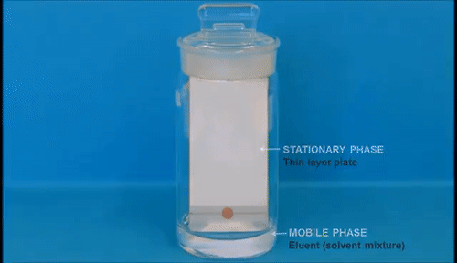
What is Chromatography?
Process for separating components of a mixture
Separation based on size, charge, polarity, solubility
Two phases – mobile and stationary

Slide 3
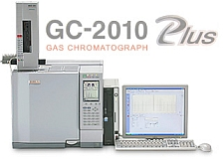
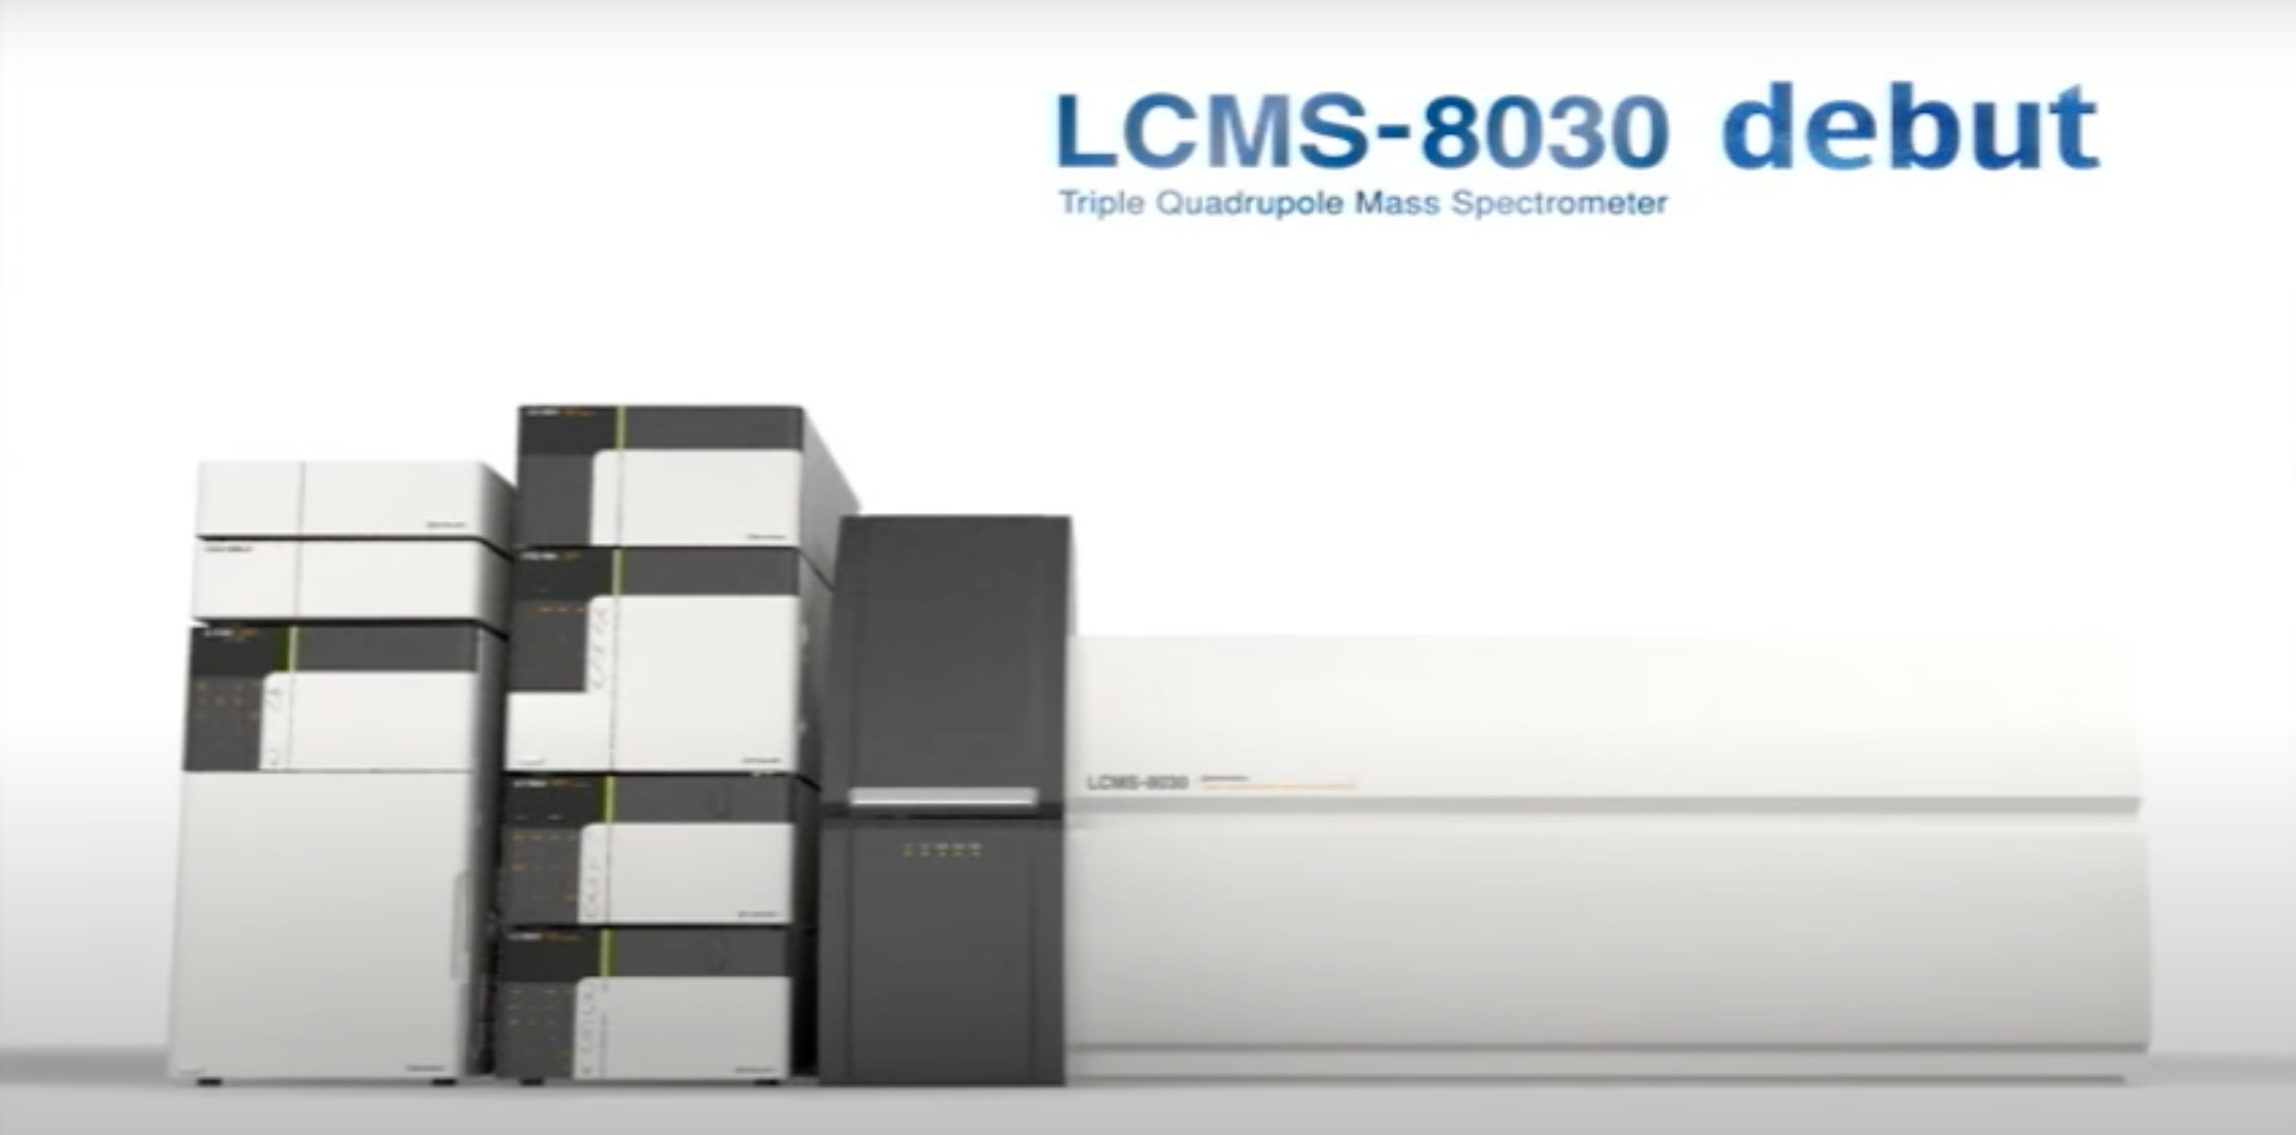
Types of Chromatography
High-Performance Liquid Chromatography (HPLC)
Mobile Phase: liquid
Gas Chromatography (GC)
Mobile Phase: gas

Slide 4
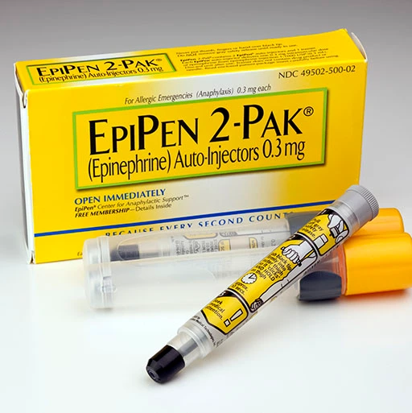
Why Study Epinephrine?
First-line medical treatment for anaphylaxis
Epinephrine autoinjector pens known as EpiPen
Degradation – extreme temperatures, UV, expiration date
Issues: short supply, costly, 18 month expiration
Project Goal: to determine if epinephrine degrades at different temperatures

Slide 5
Epinephrine Study Design
EpiPen instructions suggest:
Store at 20°C to 25°C
Excursions permitted from 15°C to 30°C
Do NOT refrigerate
Testing Temperatures: Freezer, Fridge, Room Temperature, 30-90°C
Compare Chromatography Methods: GC-MS versus LC-MS

Slide 6
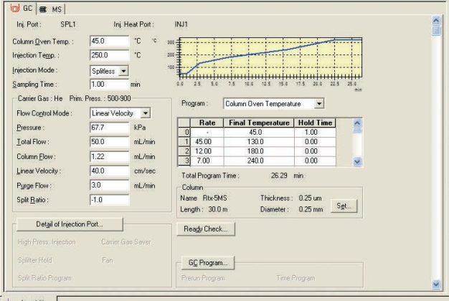
GC-MS
Shimadzu Gas Chromatograph-2010 Plus Triple Quad
Little literature research
Method development
Each run: ~10 min
Different methods tested: 31
Sample: 1 mg/mL L-adrenaline in 0.1% L-ascorbic acid solution, in methanol for volatility

Slide 7
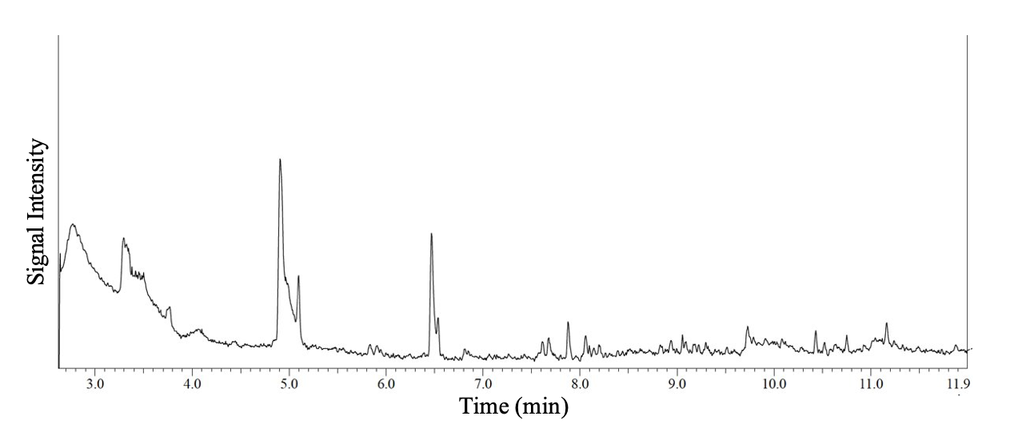
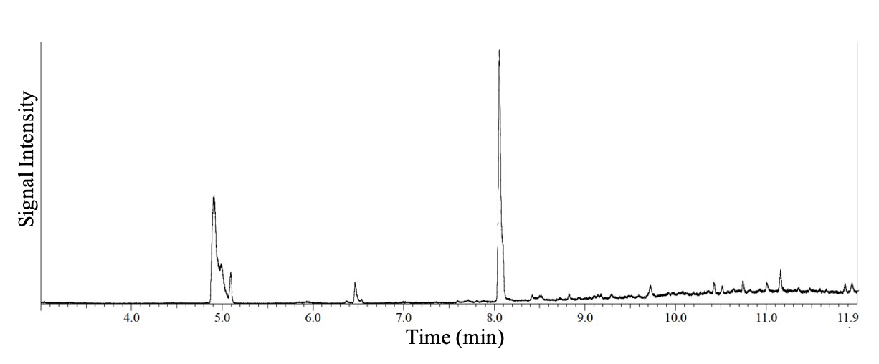
GC-MS

Slide 8
GC-MS
Troubleshooting:
Epinephrine accumulating before reaching column and detector
Precision of data varied for same sample
Manual cleaning of injection needle
Manual sample injection

Slide 9
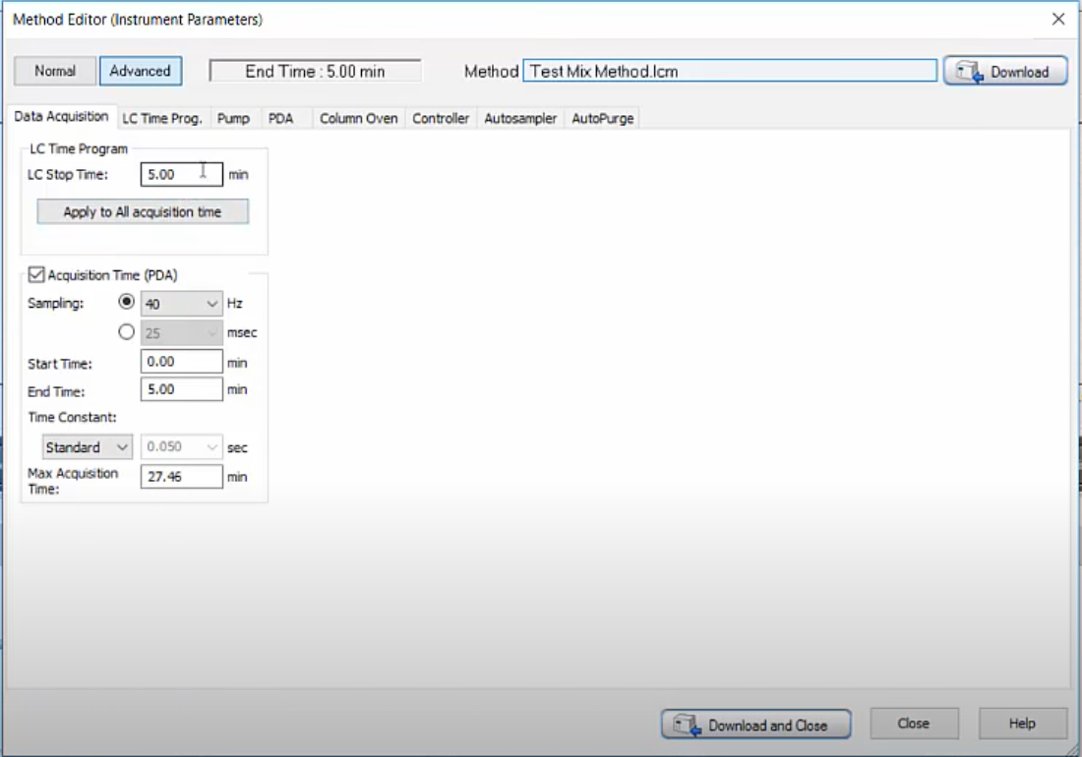
LC-MS
Shimadzu Liquid Chromatograph Mass Spectrometer – 8030 Triple Quad
More literature research
Method Development
Each run: ~ 5 min
Different methods tested: 38
Sample: 1 mg/mL L-adrenaline in 0.1% L-ascorbic acid solution

Slide 10
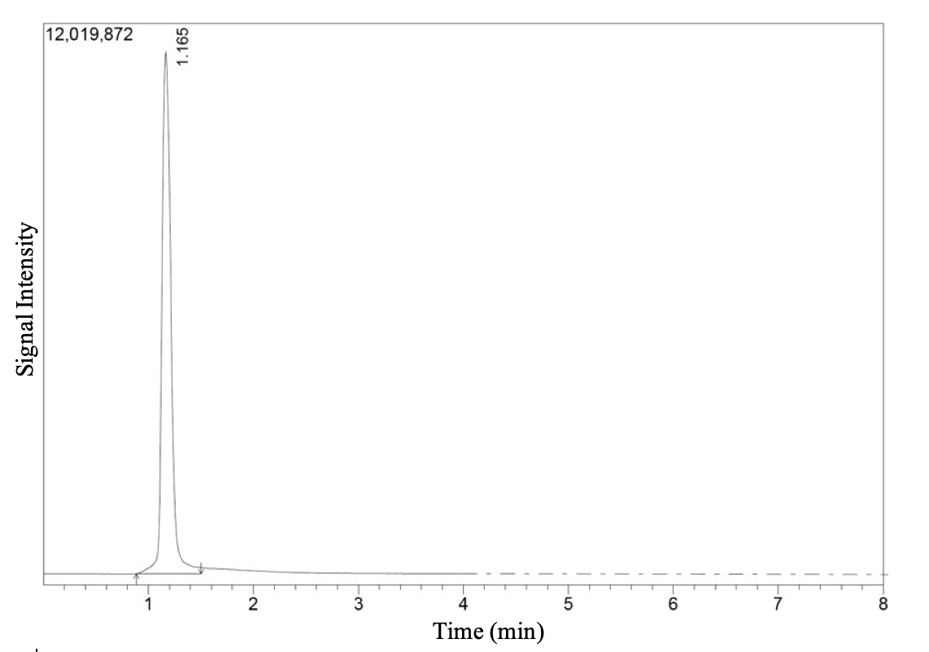
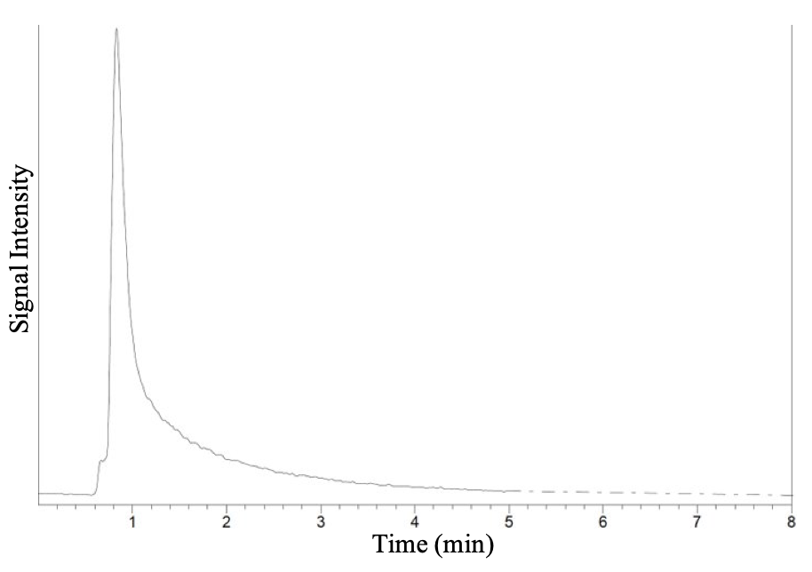
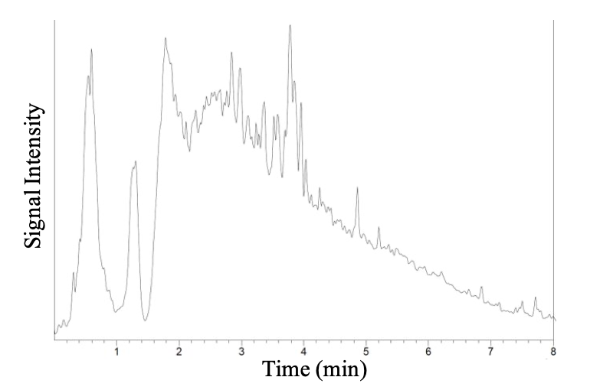
LC-MS

Slide 11
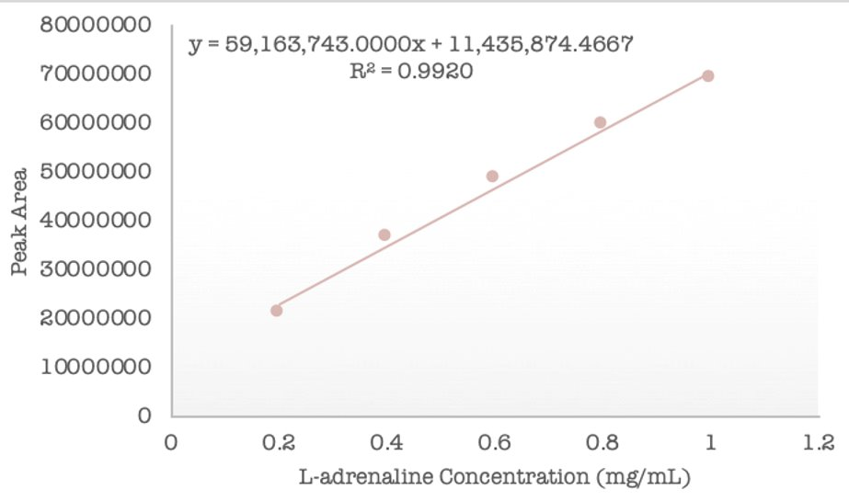
LC-MS Quantification
Using 38th method developed
Standards: 0.1-1 mg/mL L-adrenaline in 0.1% L-ascorbic acid solution
Instrument response vs. standard concentrations
Determine unknown concentration

Slide 12
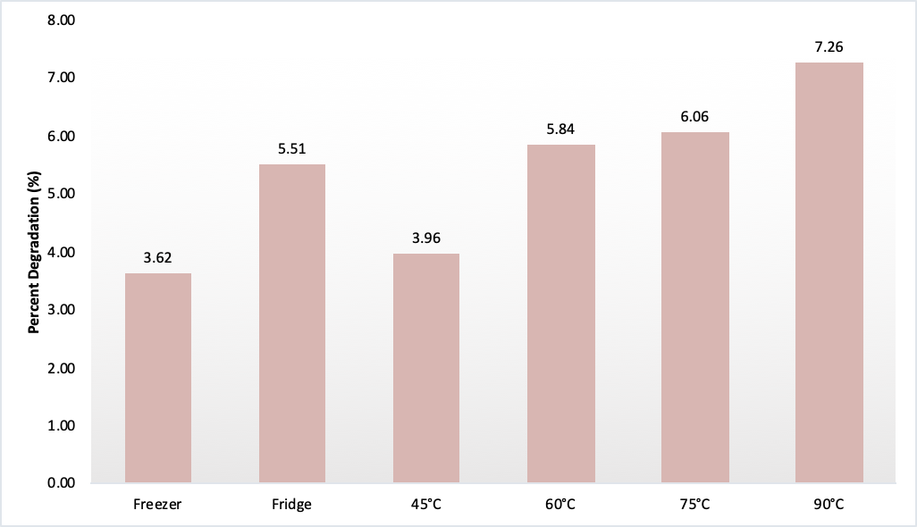
Temperature Trials
Samples held in temperature environments for 1 hour

Slide 13
Conclusion
LC-MS better method than GC-MS
Epinephrine degrades in fridge and at high temperatures
Confirm pharmaceutical company’s temperature suggestions, especially if EpiPen is not being stored continuously at room temperature
Future Directions:
Longer degradation trials – 1 hour, 2 hours, 3 hours, etc.
Troubleshooting GC-MS
L-adrenaline solutions versus EpiPen solution degradation

Slide 14
Acknowledgements
Dr. Kristina Stefaniak
Radford Chemistry Department
Honors College
Office of Undergraduate Research and Scholarship
Audience

Slide 15
References
https://gfycat.com/brightembellishedherring
https://khn.org/news/mylans-generic-epipen-a-price-break-or-marketing-maneuver/
https://www.shimadzu.eu/gc-2010-plus-high-end-gc
https://www.youtube.com/watch?v=h2Hvo9Tqn5w
https://www.chem.pitt.edu/sites/default/files/GCMSQuickGuide_Shimadzu.pdf

