Slide 1
How Curious Are You:
Effects of Curiosity on Learning
Presented by: Madison Presley

Slide 2
A WAY TO ENHANCE LEARNING
- But prior work has always used natural variations in curiosity
What is Curiosity?
(Loewenstein, G., 1994).
CAN CURIOSITY BE MANIPULATED
- Yes!
- Most studies used trivia questions
(Arnold & Marsh, 2018).
DOES CURIOSITY EFFECT LEARNING?
- This is the question we want to answer

Slide 3
Our
Hypotheses
CURIOSITY
There will be no effect of curiosity alone on learning
Prior knowledge will have an effect on learning
Curiosity is moderated by
the effect of prior knowledge on learning.
PRIOR
KNOWLEDGE
LEARNING
BOTH

Slide 4
What is Curiosity?
Participants N=177 Radford University undergraduates
Between-subjects design
Used materials were derived from prior work
New learning used pseudo-facts
Question:
Answer:
"In a kitchen, a claster is a type of what?"
"A knife"

Slide 5
PRIOR KNOWLEDGE
"When a recipe calls for zest, it is important to remember to: "
C: Refrigerate the product beforehand
D: Whip vigorously
E: I don't know
A: Use a wooden spoon
B: Clean the outer layer
NEW LEARNING
High Curiosity: "In a kitchen, a
claster is a type of what?"
Low Curiosity: "In a kitchen, a
claster is a type of knife."
HOW CURIOUS ARE YOU? (1-5 SCALE)
Answer: "Knife"
Final Test
"In a kitchen, a claster is a type of what?"

Slide 6
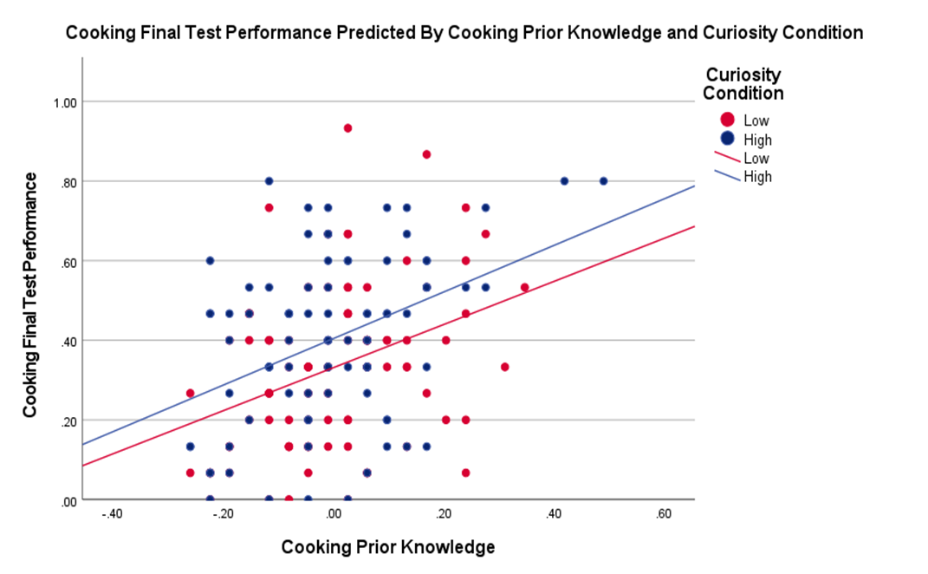
Results:
Cooking
CURIOSITY
- High curiosity led to an
increase in learning
PRIOR KNOLEDGE
- More Prior knowledge led to
an increase in learning
WAS THERE AN INTERACTION?
- No
- However, it's possible to find if
the prior knowledge was easier

Slide 7
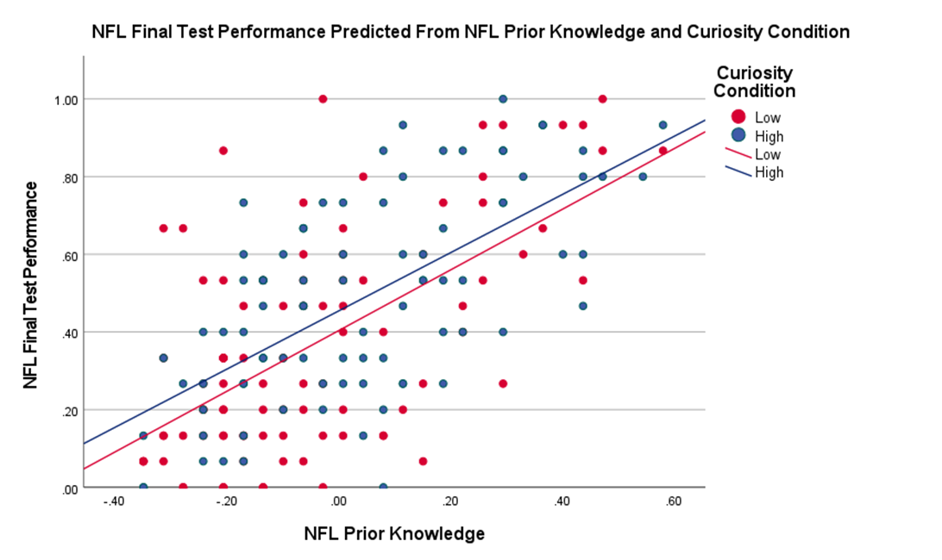
Results:
Football
CURIOSITY
- No effect on learning
- Random assignment failure
PRIOR KNOLEDGE
- More Prior knowledge led to
an increase in learning
WAS THERE AN INTERACTION?
- No

Slide 8
REPLICATE THE STUDY
Future
Directions
- Clear up confusion with failure in random assignment
REVISE COOKING QUESTIONS
- Prior knowledge may have still
been too difficult

Slide 9
WHY IS THIS IMPORTANT?
- A step closer to understanding curiosity's relationship to learning
Discussion
HOW CAN THIS BE APPLIED?
- Professors, start adding questions to your lectures!

Slide 10
Questions?
Special Thanks to:
Ryan Taylor, Dr. Kathleen Arnold,
and the Honors College

Slide 11
References
Arnold K. M. & Marsh, E. J. (2018). Inducing Curiosity: Can Making Students More Curious Enhance Learning?.
Loewenstein, G. (1994). The psychology of curiosity: A review and reinterpretation. Psychological Bulletin, 116(1), 75–98. https://doi-org.lib-proxy.radford.edu/10.1037/0033-2909.116.1.75
Wade, S., & Kidd, C. (2019). The role of prior knowledge and curiosity in learning. Psychonomic Bulletin & Review, 26(4), 1377–1387. https://doi-org.lib-proxy.radford.edu/10.3758/s13423-019-01598-6
Witherby, A. E., & Carpenter, S. K. (2021). The rich-get-richer effect: Prior knowledge predicts new learning of domain-relevant information. Journal of Experimental Psychology: Learning, Memory, and Cognition. https://doi-org.lib-proxy.radford.edu/10.1037/xlm0000996

