Slide 1
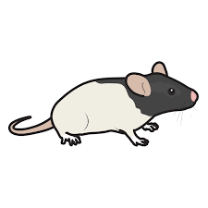
The Effects of Maternal Separation on Oxytocin Expression in Rats
Lauren Seedlock & Dayna Hayes

Slide 2
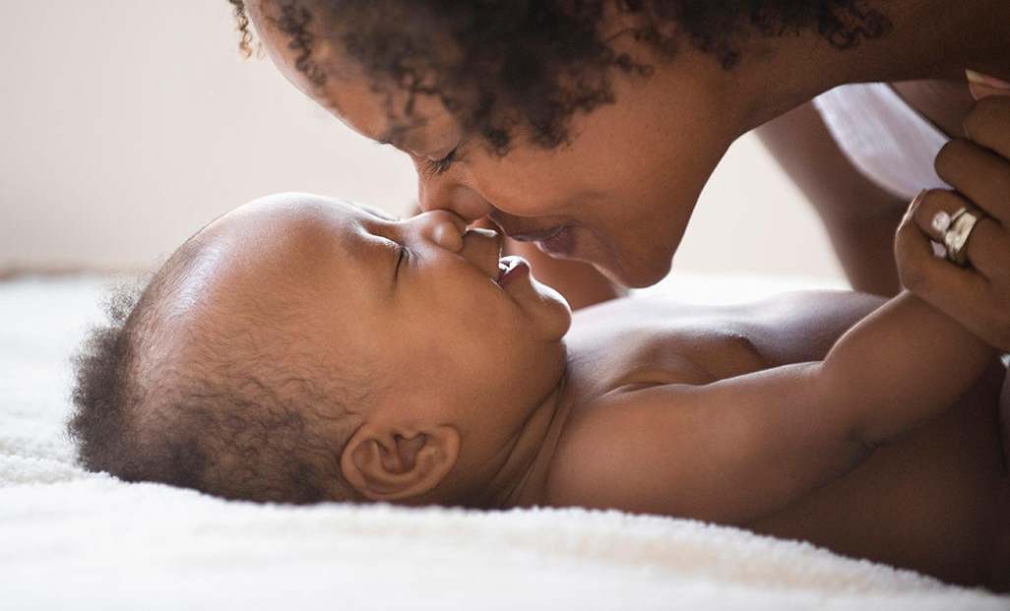
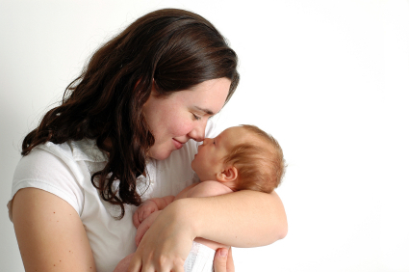
Maternal Attachment
Maternal attachment is the bond between a mother and its young, to preserve the species through nurturing and protective behaviors.
A lack of attachment has been linked to an impairment in children’s social, emotional, and cognitive development (Alhusen et al. 2013).
Notes:
Baby picture
Rat Pictures

Slide 3
Adoptions
There are over 153 million orphans worldwide currently and over 135,000 children adopted in the US each year.
11% of adoptions fail or are “disrupted.”
There is a correlation between the age and likelihood of disruption.
Reactive Attachment Disorder (RAD) prevents children from forming a healthy attachment to their caregivers.
Notes:
To give you some background about what drew me into this research; I personally was adopted. I was adopted from birth so statistically my chance of disruption was low about 1-7% : however kids who are adopted later in life have a likelihood of disruption of 5-20%.

Slide 4
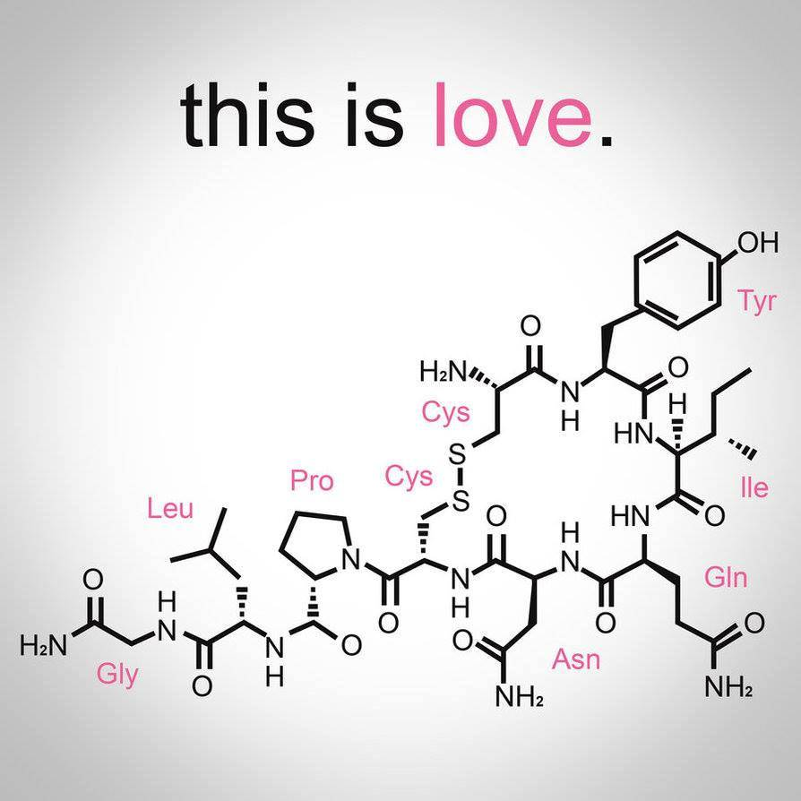
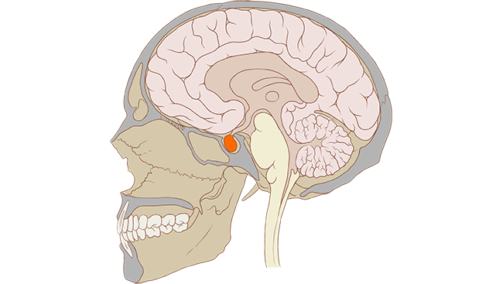
Oxytocin
Known as the “love” hormone.
Plays a key role in social cognitions, social behaviors, fear conditioning, and social anxiety (Jones 2017).
Notes:
Released from the posterior pituiatary gland (shown in picture)

Slide 5
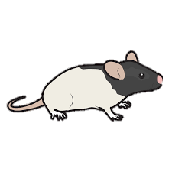
Treatment
Mom
Yes | No
Notes:
Rats are born in the third trimester but PND 50 when the brains were taken they are equivalent to college aged students.

Slide 6
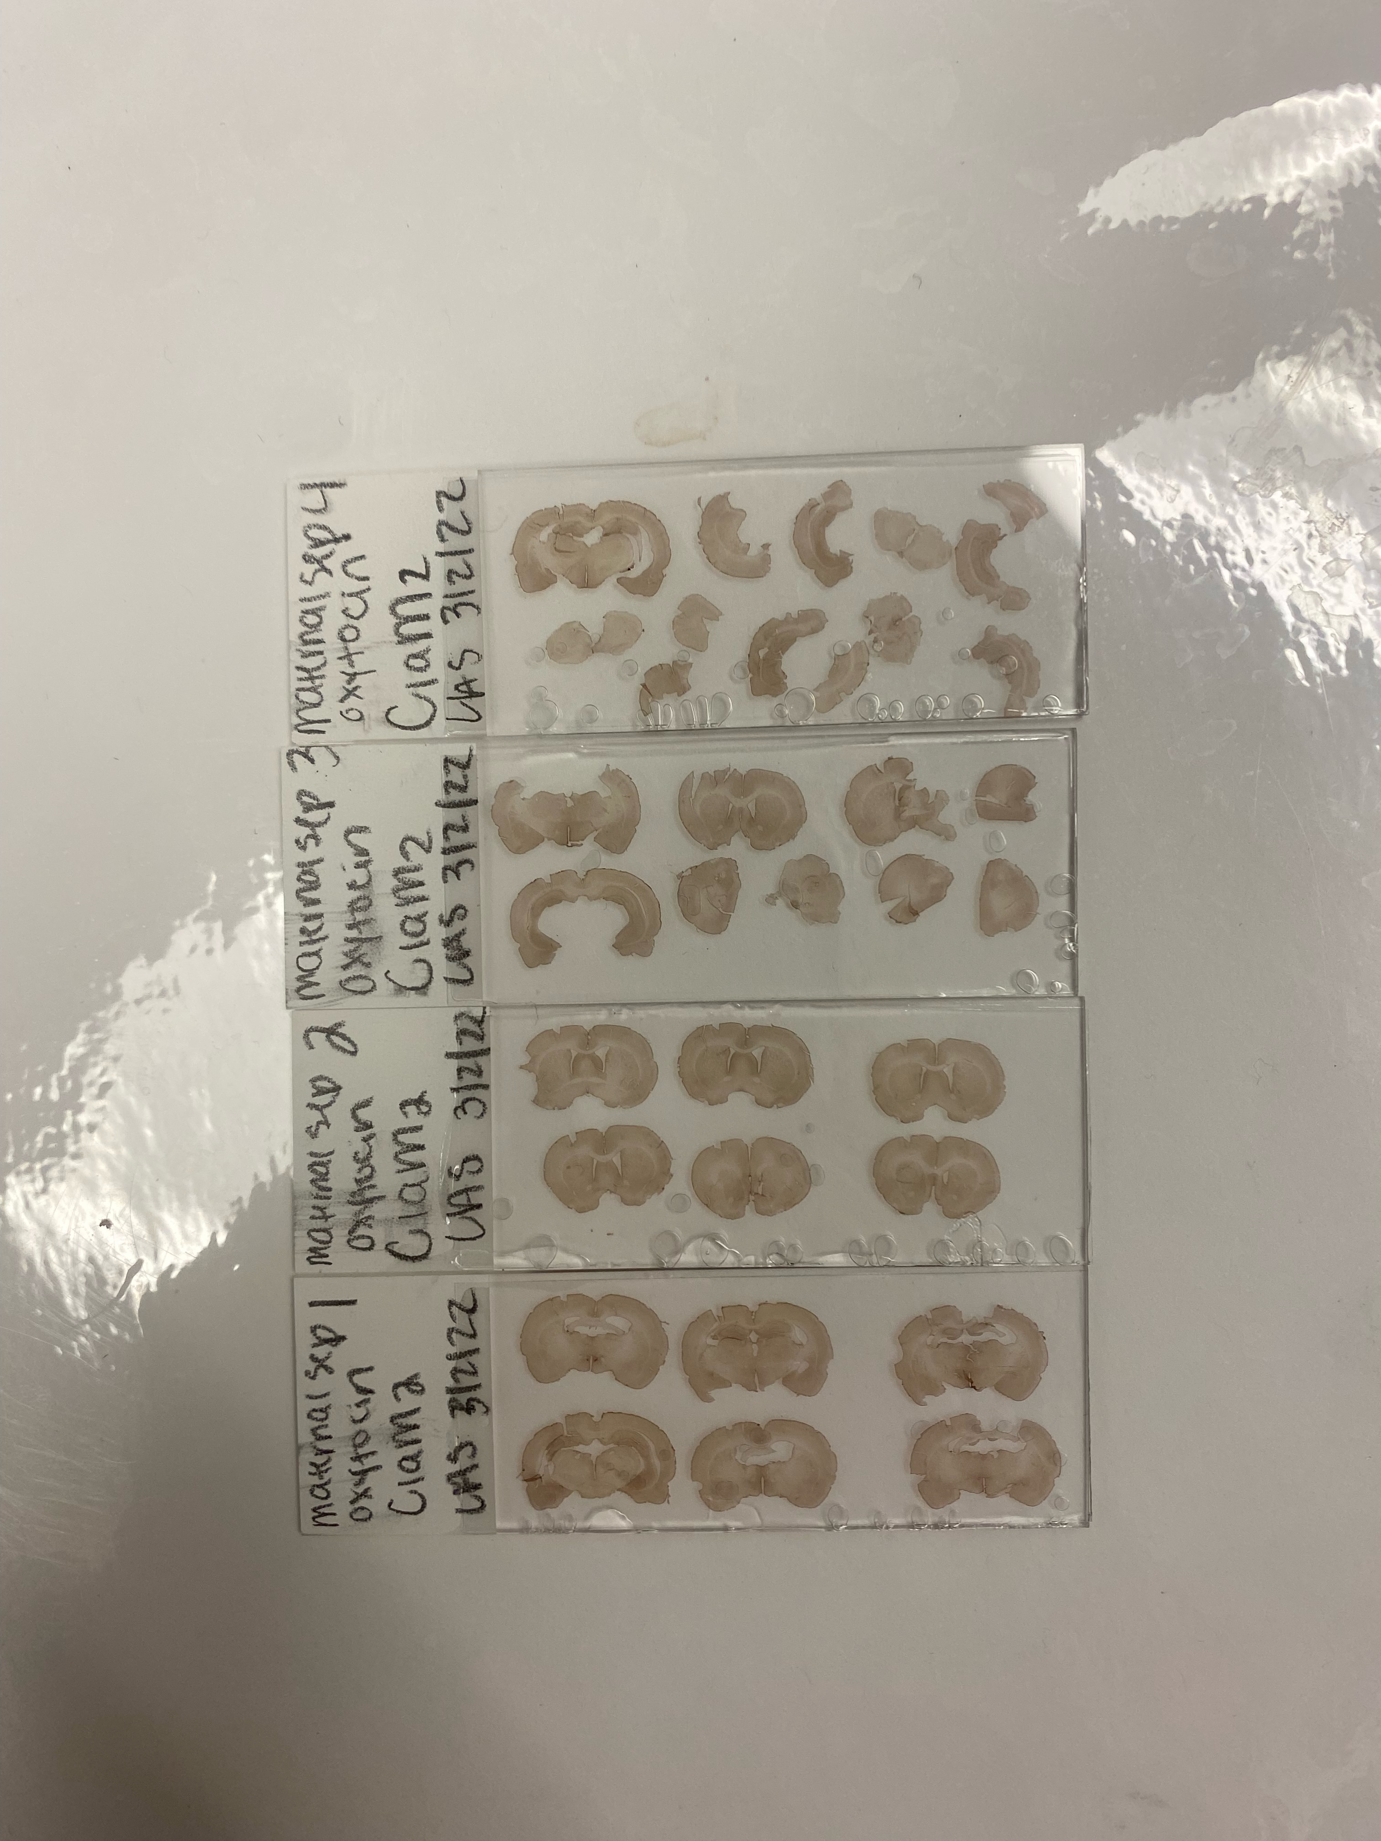
Tissue Collection
Vibratome slicing
Immunohistochemistry
Mounting
Notes:
Concentration and antibody

Slide 7
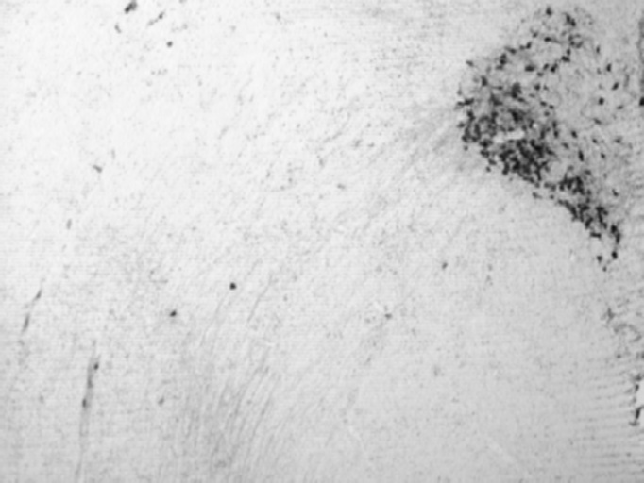
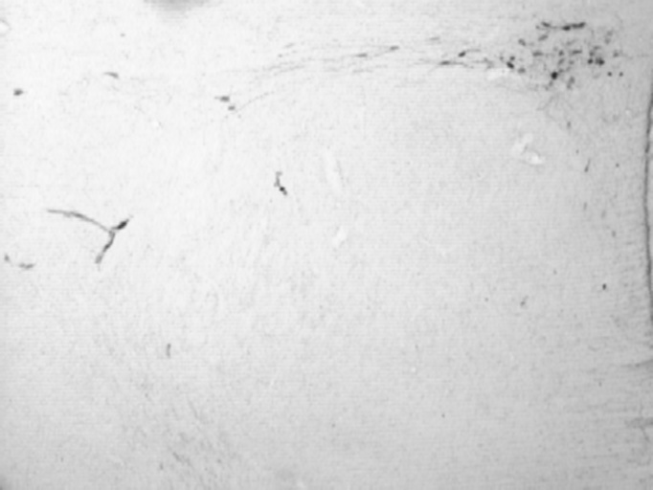
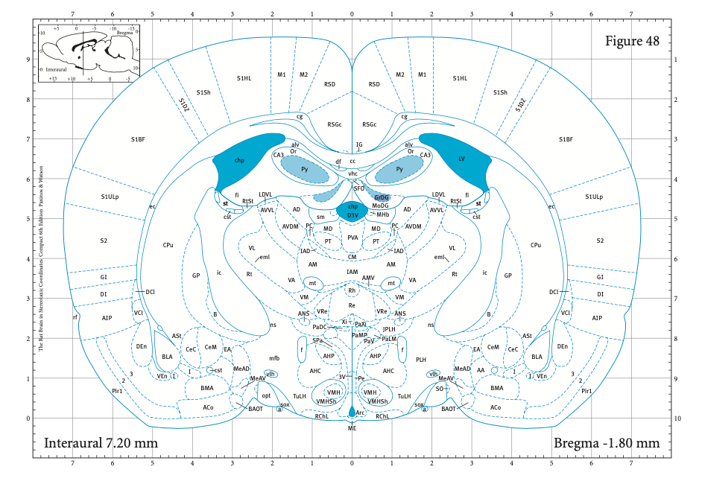
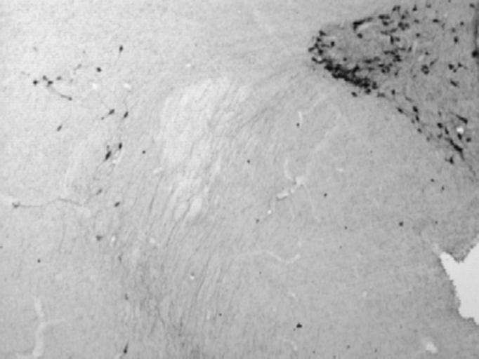
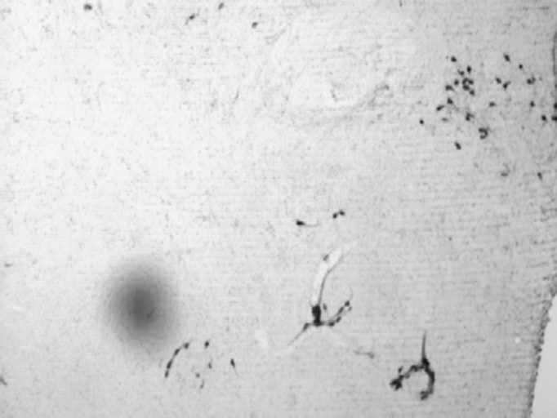
Quantifying

Slide 8
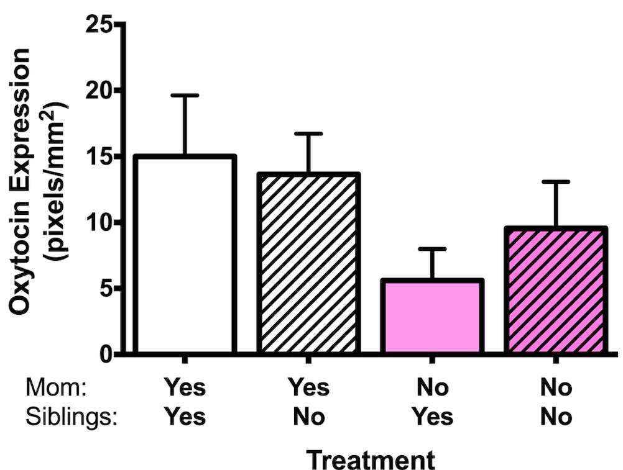
Preliminary Results
Main Effect of Mom
F(1,12)= 3.711 ; p= .078
Main Effect of Sibling
F(1,12)= .137; p=.718
Interaction
F(1,12)= .575 ; p=.463
Notes:
Average of left two groups is almost more than average of right two groups
Main effect of siblings is an average of these two groups vs these two which showed no difference
Basically the love hormone is elevated if mom is around

Slide 9
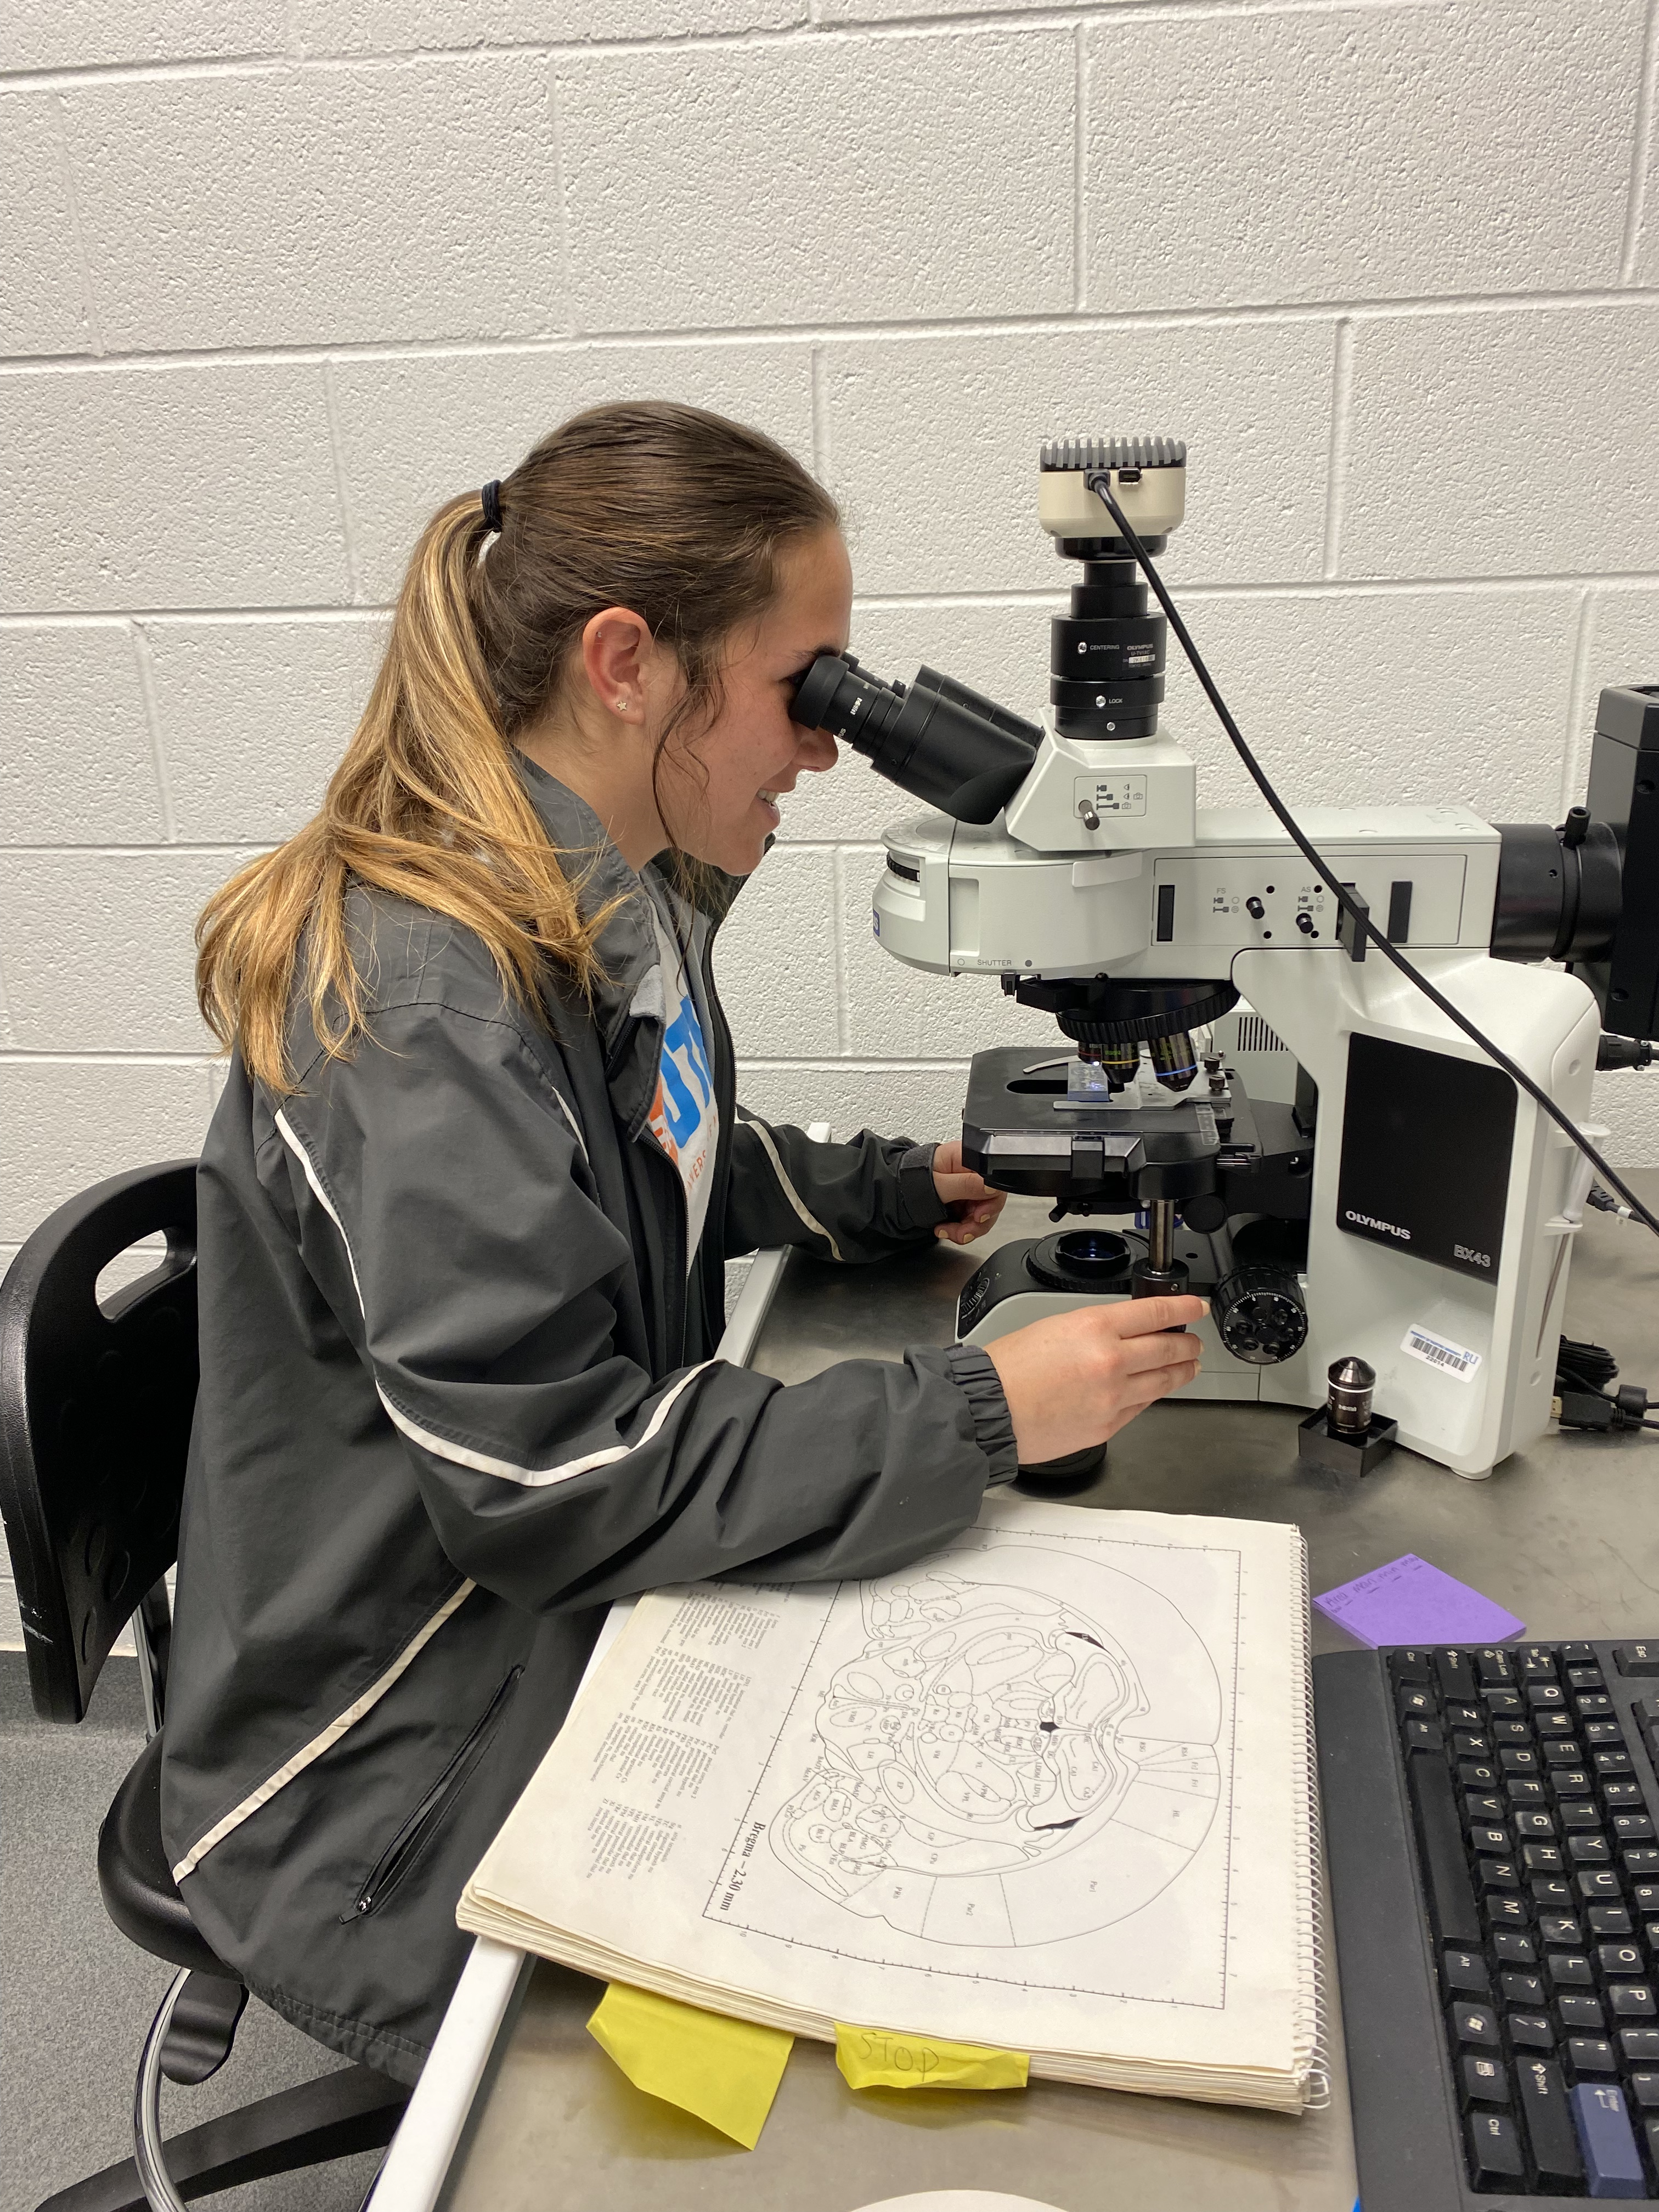

Slide 10
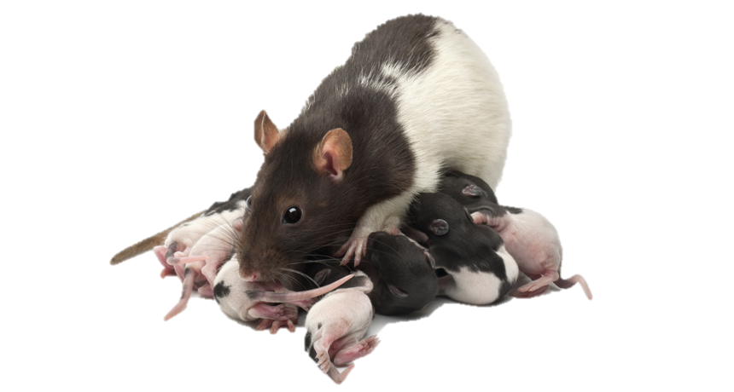
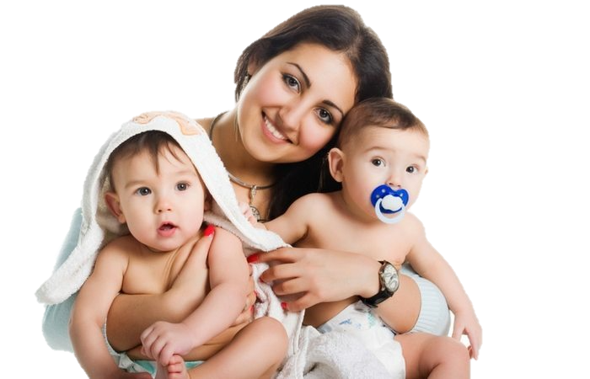
Conclusion
While other hormones play a role in maternal attachment, it is seen here that presence of mom is the biggest factor when looking at oxytocin levels.
More research needs to be done on the neurobiological effects in children with Reactive Attachment Disorder.

Slide 11
Special thanks to current Behavioral and Cognitive Neuroscience (BaCON) laboratory team members who have contributed to this project. Thank you to the Radford University Psychology Department for research support and the Radford University Honors College.
QUESTIONS?

Slide 12
Woodward, L., Fergusson, D. M., & Belsky, J. (2000). Timing of Parental Separation and Attachment to Parents in Adolescence: Results of a Prospective Study from Birth to Age 16. Journal of Marriage & Family, 62(1), 162. https://doi-org.radford.idm.oclc.org/10.1111/j.1741-3737.2000.0016
Alhusen, J. L., Hayat, M. J., & Gross, D. (2013). A longitudinal study of maternal attachment and infant developmental outcomes. Archives of women's mental health, 16(6), 521–529. https://doi.org/10.1007/s00737-013-0357-8
Schoenmaker, C., Juffer, F., van IJzendoorn, M. H., Linting, M., van der Voort, A., & Bakermans-Kranenburg, M. J. (2015). From maternal sensitivity in infancy to adult attachment representations: a longitudinal adoption study with secure base scripts. Attachment & Human Development, 17(3), 241–256. https://doi-org.radford.idm.oclc.org/10.1080/14616734.2015.1037315
https://www.adoptionchoicesoftexas.org/what-happens-when-adoption-fails/
Vasquez, M., & Stensland, M. (2016). Adopted children with reactive attachment disorder: A qualitative study on family processes. Clinical Social Work Journal, 44(3), 319–332. https://doi-org.radford.idm.oclc.org/10.1007/s10615-015-0560-3

