Slide 1
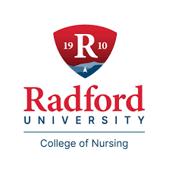
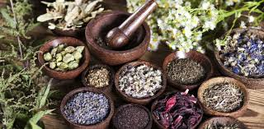
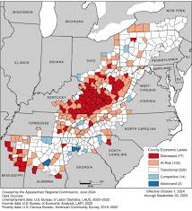
Appalachian Home Remedies
by. Sydney Salyers
Radford University Honors College and College of nursing, faculty: Anne Prucha
Appalachian Region
History of Appalachian Folk Medicine
Folk Medicine as a Solution
Appalachia is located on the eastern side of the United States. The region includes states ranging from Mississippi to New York. Appalachia is made up of 423 counties across 13 states and spans 206,000 square miles (About the Appalachian region 2024).
In the Appalachian Mountains, folk magic goes by many names: root work, granny magic, kitchen witchery, Braucherei, and witchcraft. The first people to combine Appalachian nature and spiritual ritual were the Cherokee and Choctaw tribes. They were experienced healers and herbalists (Cieslik)..
Folk medicine can potentially be a solution to health disparities by providing culturally relevant and accessible healthcare options to marginalized communities, particularly when integrated with conventional medicine. It often includes readily available natural remedies, aligns with cultural beliefs, and can overcome barriers like language and cost, thereby improving access to care for underserved populations. Certain herbs have been proven to be quite effective in treating minor ailments. “Roughly a third of all medicines are derived from plants” (Appalachian home remedies: A collection from Radford University's staff and students 2003).
When these Scottish, Irish, and English settlers arrived, they combined their traditional practices with Native American knowledge about flowers, berries, roots, and leaves native to Appalachia. The settlers from the Scottish highlands and Africa also shared their own knowledge of medicinal plants and remedies. From this melting pot the tradition practiced mostly by familial matriarchs became coined as ”Granny Magic”. Within this tradition, older women, called grannies, served as midwives, healers, and stewards of ancestral knowledge within their communities (Cieslik).
Healthcare in the Appalachian region
The Appalachian region has been labeled as a healthcare desert. “The Appalachian Region has 66.8 primary care physicians per 100,000 population, which is 12 percent lower than the national average of 75.6 primary care physicians per 100,000” (Marshall & PDA, 2021). In addition to lack of providers many areas of the region are very rural with the closest healthcare facility being miles away. Additionally socioeconomic status plays a large role in accessing care. In our region alone the poverty rate may be up to 50%, making appointments and medications extremely inaccessible for many people (Robert S Cowell)
Benefits to This Approach
free or low-cost everyday ingredients
Free information available
Culturally significant
Doesn’t require insurance or transportation
Barriers
Appalachia economics by county
Accurate and safe information
Effective treatments
Risk for drug or allergic reactions
Plants and certain ingredients may not grow within close distance
References
About the Appalachian region. Appalachian Regional Commission. (2024, November 25). https://www.arc.gov/about-the-appalachian-region/#:~:text=Appalachia%20is%20made%20up%20of,New%20York%20to%20northern%20Mississippi.
Alwhaibi, M., Goyat, R., & Kelly, K. M. (2017). The use of herbal remedies among mothers of young children living in the Central Appalachian region. Evidence-Based Complementary and Alternative Medicine, 2017(1). https://doi.org/10.1155/2017/1739740
Appalachian Regional and Rural Studies Center. Radford University. (2003, December 4). Appalachian home remedies: A collection from Radford University’s staff and students. Créez votre bibliothèque numérique. https://monk.radford.edu/records/item/25312-appalachian-home-remedies-a-collection-from-radford-university-s-staff-and-students?offset=5
Cieslik, E. (n.d.). Appalachian Folk Magic: Generations of “granny witchcraft” and spiritual work. Smithsonian Center for Folklife and Cultural Heritage. https://folklife.si.edu/magazine/appalachian-folk-magic
Marshall, A. J. L., & PDA, A. O. (2021, February 3). Health Disparities in Appalachia. Appalachian Regional Commission. https://www.arc.gov/report/health-disparities-in-appalachia
Robert S Cowell, Jr. (n.d.). A Virginia Mountain City responds to the challenge of improving health outcomes. UKnowledge. https://uknowledge.uky.edu/jah/vol1/iss3/4/
Currant Usage
“Herbal remedies are commonly used among women living in the Central Appalachian Region, a region with lower education and income level. Therefore, public health interventions about the types, safety, and efficacy of herbal remedies may improve health within this population”. Many women in this area, which is known to be one of the poorest in the region, use home remedies for cold and flu-like symptoms, improving breast milk supply, and treating minor wounds (Alwhaibi et al., 2017).

