Slide 1

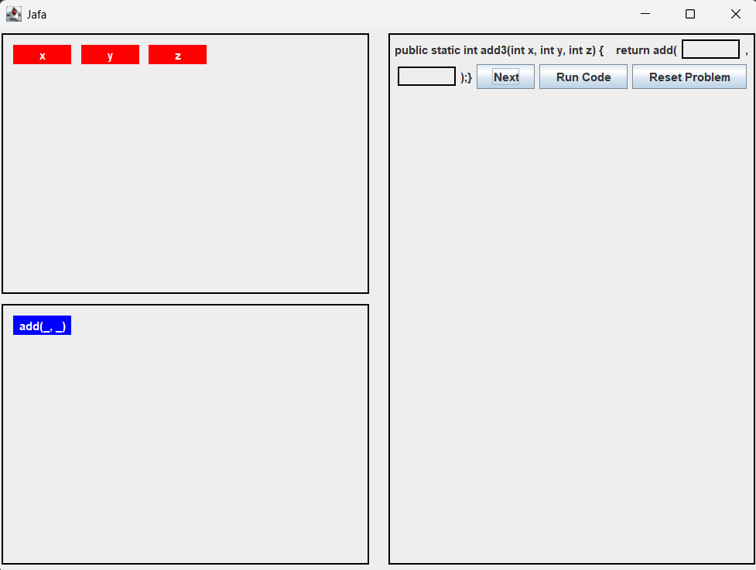
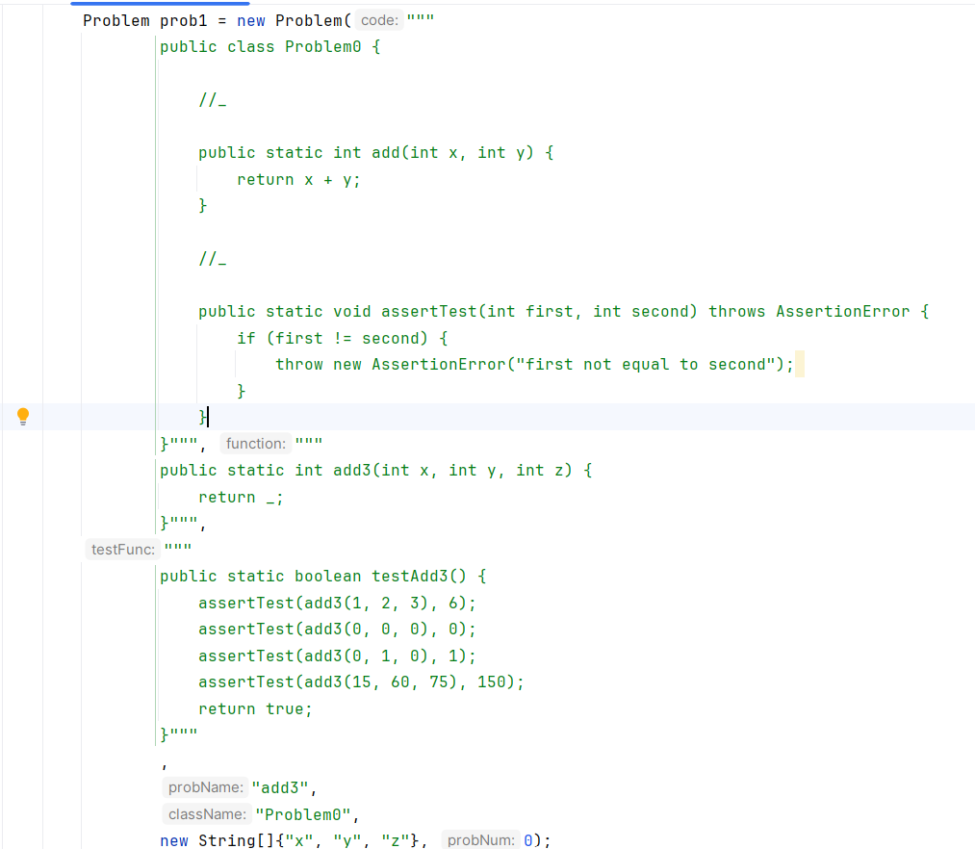
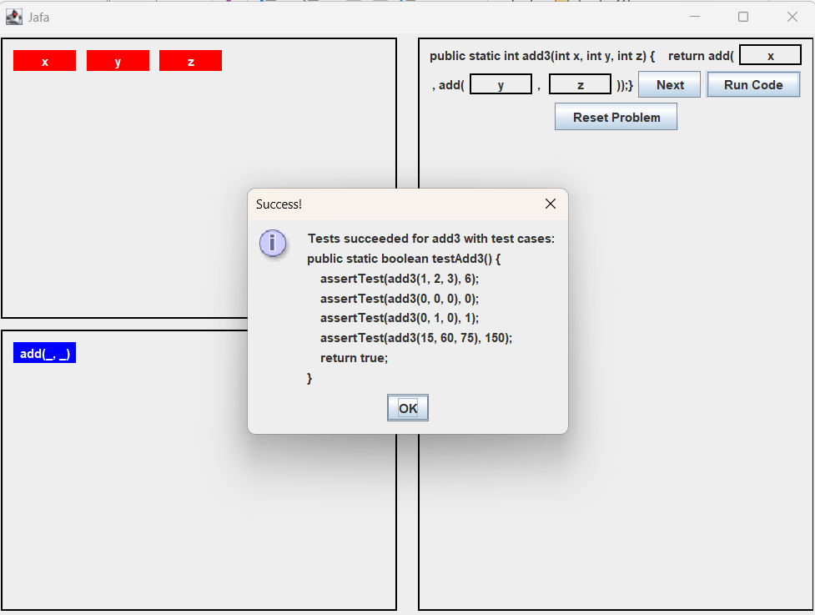
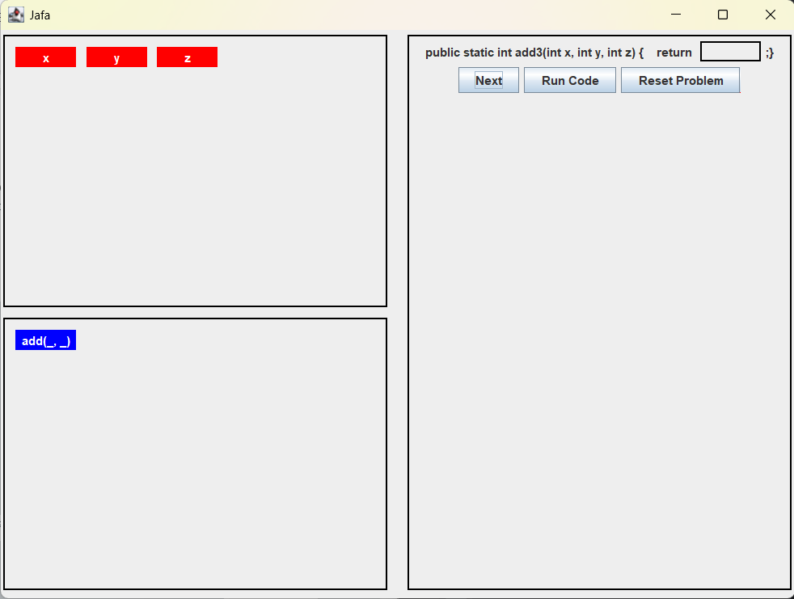
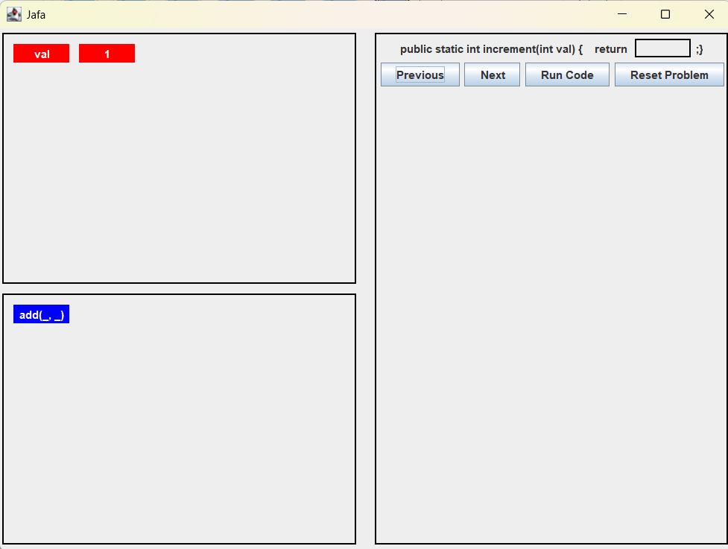
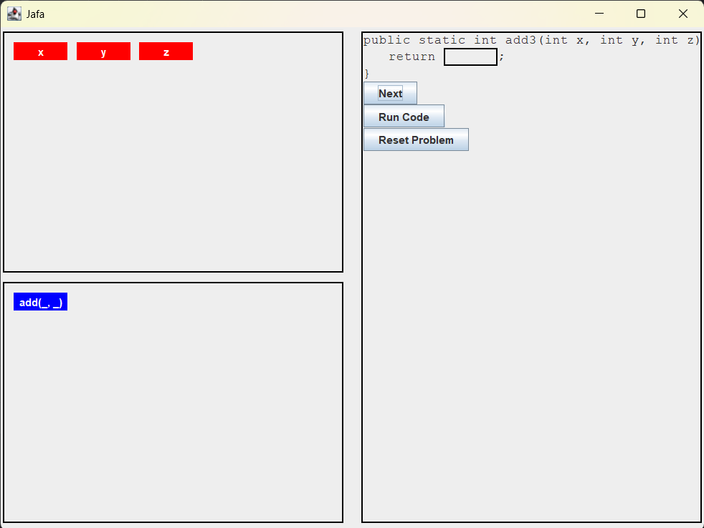
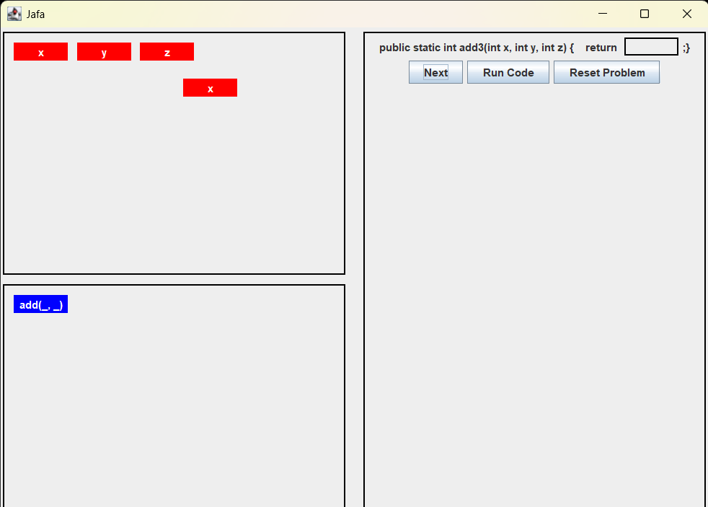
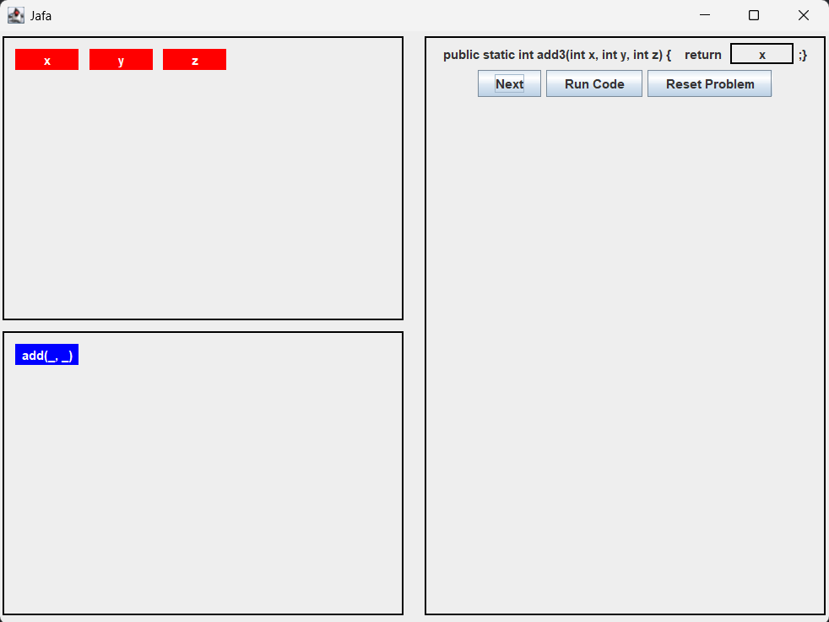
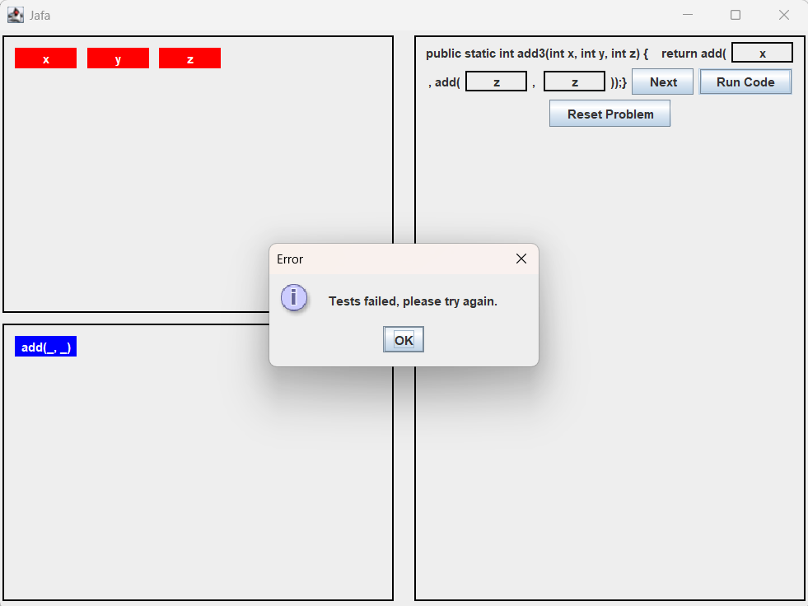
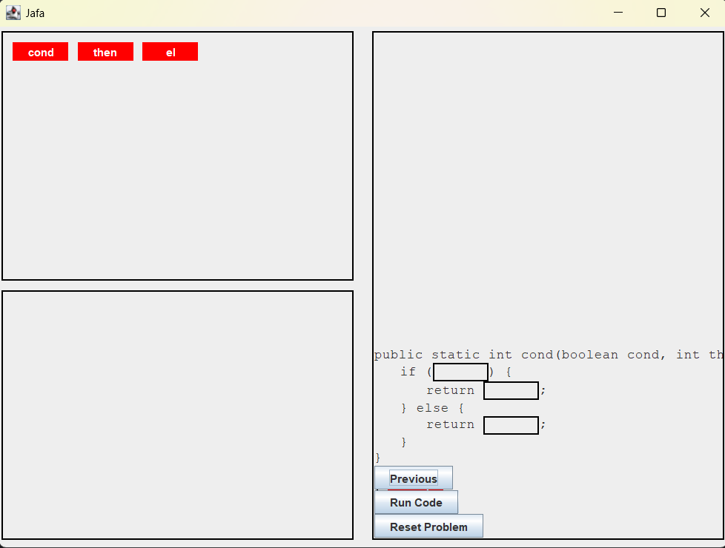
Syntax Free Software Application for Intro Computer Science Courses
Jordan Stuck,
Dr. Nathaniel Lahn
How Can This Be Implemented?
Professors will be able to:
Create their own problem sets based on format below
Provide problems containing:
Wrapping class (including two “//_” for the student and test function) containing helper functions and assertTest.
Function the student will modify (including “_” for student input)
Test function
Name of the function
Name of the class
Parameters/constants/primitives
Problem number (Starting at 0)
Why Develop this Software?
The Development Process Continued
As a peer instructor I have seen many students going through Computer Science courses without understanding important concepts. Some of these concepts are as follows.
Functions/Methods
Control Flow
Variables
Recursion
Memory Management
These are foundational topics that computer science students need to know in order to be successful in their studies and future careers. The challenge of teaching introductory level courses is trying to separate these important topics from learning the syntax (how to code) of a specific programming language. It’s important to try to separate these so the students can focus on the fundamentals before they dive headfirst into coding.
Image showing function dragged into placeholder
The Development Process
Adding functions to code panel:
Kept track of number of arguments
Code panel updates dynamically based on number of arguments
Considered the case where there was text in the other placeholder boxes
Kept track of the location of the text and added the text to the right box after adding new boxes from the function
This project is intended to help promote students learning key concepts without worrying about syntax. Here’s a walk through of the development process that was taken:
Small Incremental changes every week
Layout
Draggable Labels
Screenshot of Professor’s input
Next Steps
Areas this project could improve:
Format the code panel to emulate an actual program.
Provide problem descriptions
Keep track of student scores
Basic Layout of the Application
Success Message
Image of formatted solution
Image Displaying after user has dragged variable to a placeholder box
Image of formatted solution with errors
Challenges for drag and drop:
Transfer rectangle from one panel to another
Completed by making ‘parent’ panel with inner panels
Pasting contents of rectangle into code panel (right rectangle)
I kept track of the location of mouse and the target rectangle
Error Message
Challenges with formatting:
Wrapping text in the code panel
Refactoring code based on formatting
Use of AI during this project:
Explored the Swing library using AI
Debugged code using AI
Discovered pop up message functionality using AI
References
AI was utilized responsibly throughout this project

