Slide 1


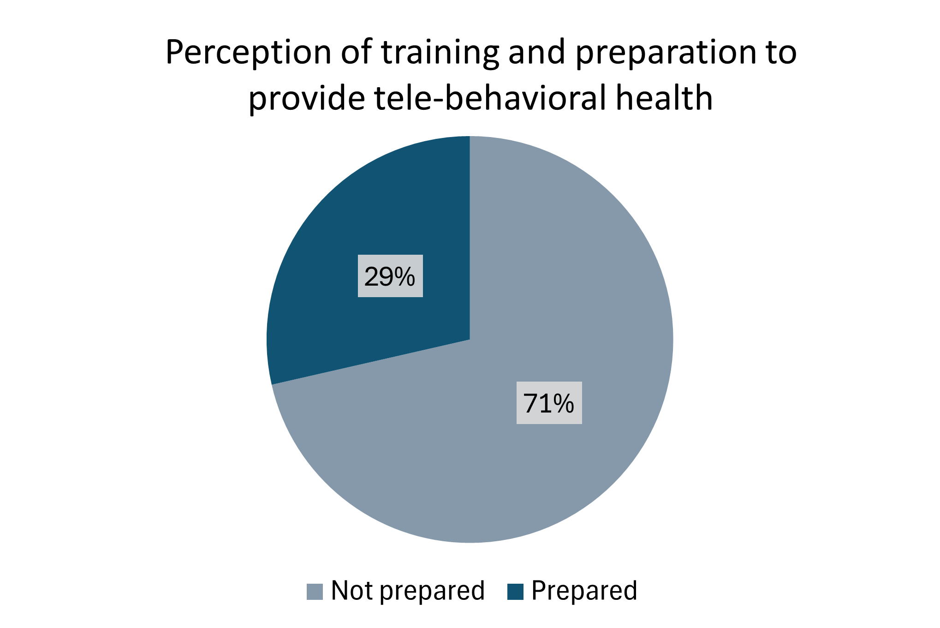

Preparing social workers for telehealth practice: Experiences and insights
Hayley Bare & Sarah Rakes, PhD, LCSW
School of Social Work, Radford University
Background
Results
Conclusions
The COVID-19 pandemic dramatically increased the use of tele-behavioral health, with over 92% of social workers reporting they have used it since 2020, compared to just 28% before (Lombardi et al., 2022). Despite this shift, only half of practitioners received any telehealth training.
Social workers are trained for in-person interactions that rely on nonverbal cues and relationship-building. Transitioning to virtual platforms creates challenges in technology use, client engagement, and ethical concerns.
Without proper support, social workers may struggle with adapting their skills, maintaining therapeutic connections, and managing legal and professional responsibilities.
This study explores how recent MSW graduates navigate telehealth, identifies gaps in their training, and suggests improvements for social work education.
A total of 7 respondents completed the survey.
71.43% of respondents disagreed with the statement "the training I received adequately prepared me for tele-behavioral health."
In qualitative responses, respondents noted gaps in training stating, "I was never trained on providing telehealth services" and "I had to go looking for CEU's on this topic."
The majority of responses indicated confidence in ability to use technology effectively (m=4).
Responses to the statement "I feel well-equipped to handle ethical and legal issues unique to online counseling" ranged from somewhat disagree to strongly agree (m=3.57).
Respondents that they experienced challenges at times with establishing rapport, adapting practice skills to telehealth, and responding to crisis situations.
Most reported feeling unprepared for tele-behavioral health, pointing to gaps in training and the necessity of pursuing continuing education.
Confidence in addressing ethical and legal issues was mixed, with discrepancies in readiness.
Training should incorporate crisis intervention, ethical decision-making, and transferring in-person skills to online environments.
Graduate programs and professional groups must increase telehealth training through formal means and clear protocols.
Methods
This study used a mixed-methods approach to explore MSW graduates’ experiences with telehealth. An online Qualtrics survey was sent to approximately 90 recent graduates. The survey included Likert scale and open-ended questions on training, technology use, client engagement, and ethical concerns.
Quantitative data was analyzed using descriptive statistics, while qualitative responses underwent thematic analysis to identify key trends.
Data collection took place from December 2024 to February 2025, following approval from the Radford University IRB.
ThePhoto by PhotoAuthor is licensed under CCYYSA.
References
Printing Supported by the RU Office of Undergraduate Research & Scholarship

