Slide 1
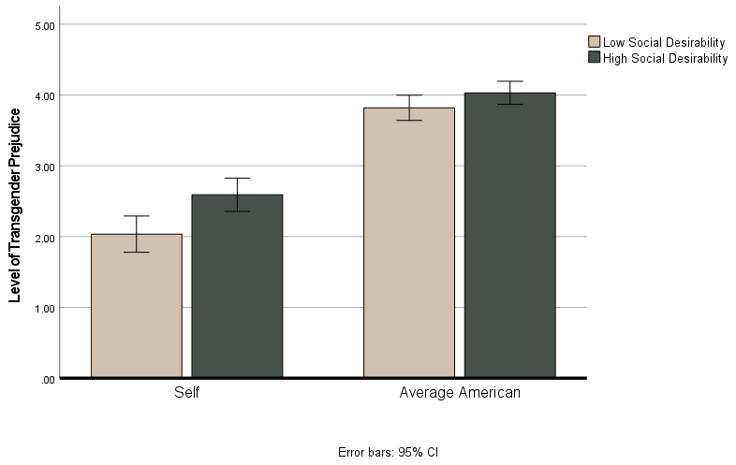
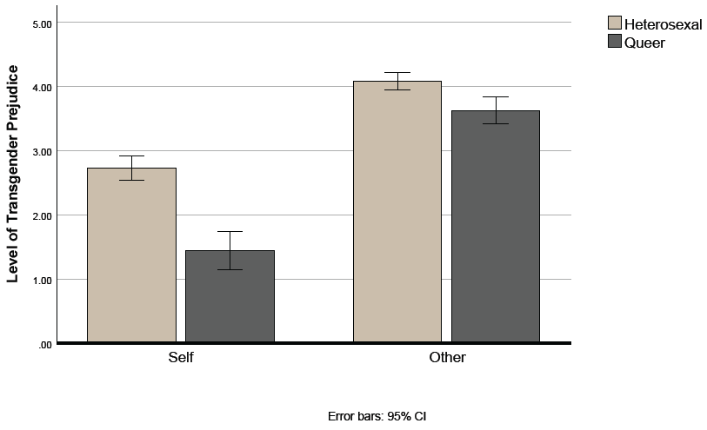
Pluralistic Ignorance Within Attitudes Toward Transgender Individuals
Brittle K. Williams, Jeffrey E. Aspelmeier Ph.D.
Department of Psychology, Radford University
Background
Table 1: Mixed Model Factorial ANOVA
Results
- This study investigates pluralistic ignorance (PI) within
attitudes toward transgender individuals.
- PI occurs when members of a group incorrectly believe
that their private attitudes differ from the group norm,
which leads to conformity, making their public
behaviors reinforce the false norm (Lambert et al,
2003; Miller & MacFarland, 1991).​
- Social desirability, the tendency for individuals to
frame themselves in a favorable light, can produce
similar data to PI so it must be ruled out. (Paulhus,
1991)​.
- This study measures transgender prejudice, negative
attitudes towards transgender individuals, ac.
- This research is needed due to the high levels of
violence that transgender people are victim to because
of the prejudice they experience (James et al., 2016;
Lombardi et al. 2001).
- Previous PI studies on the topic of prejudice have
found PI contributing to racial segregation
(O’Gorman, 1975) and same-sex marriage (Perryman
et al., 2018).
- In this study we expected to find PI within transgender
attitudes and rule out social desirability as an
alternative explanation for these findings.
Effect | SS | df | F | p | η2 partial
Target (Self v. Other) | 316.21 | 1 | 318.02 | <.001 | .57
Soc. Des. (High v. Low) | 17.94 | 1 | 9.87 | .002 | .04
Interaction | 3.63 | 1 | 3.66 | .056 | .02
Error Within Subjects | 241.61 | 243
Error Between Subjects | 441.68
Main Effect of Target: Participants reported significantly more positive transgender attitudes (M = 2.34, SD = 1.40) compared to the average American (M = 3.93, SD = 0.96; see Figure 1).
Main Effect of Social Desirability: Participants low in social desirability reported significantly more positive attitudes for self (M = 2.92, SE = .09) and less positive transgender attitudes for average American (M = 3.31, SE = .08; see Figure 1).
This interaction was significant with a small effect (see Table 1). These data rule out social desirability as an alternative explanation for PI.
Main Effect of Sex. ID: Heterosexual participants reported less positive transgender attitudes (M = 2.73, SD = 1.45) than queer participants (M = 1.44, SD = .61; see Figure 2). Queer participants estimated average American attitudes as more (M = 3.63, SD = .89) than heterosexuals (M = 4.08, SD = .93).
This interaction is significant with a very large effect (see Table 2). These data show a larger magnitude of PI within queer participants; however, they also estimated attitudes of the average American more accurately.
Figure 1: Trans Prejudice: Self v. Avg American
Table 2: Mixed Model Factorial ANOVA
Effect | SS | df | F | p | η2 partial
Target (Self v. Other) | 317.35 | 1 | 342.35 | < .001 | .58
Sex. ID. (Hetero v. Queer) | 77.54 | 1 | 50.57 | < .001 | .17
Interaction | 17.88 | 1 | 19.31 | < .001 | .07
Error Within Subjects | 226.90 | 245
Error Between Subjects | 374.92
Method
Discussion
Participants: N = 245 (49.4% Females, 47.8% Males, 2.4% Other)
Age: 19-80 (M = 36.28, SD = 12.82)
Ethnicity: European Am. - 72.7%, African Am. - 9.0%, Asian/Pas. Islndr 4.1%, Hisp/Lat. Am. 8.2%, Other 6.0%
Sexuality: Hetero 69.8%, Homo 7.3%, Bi 14.7%, Other 8.2%
Measures: (1) Transgender Attitudes - Combined Genderism and Transphobia Scale (Tebbe et al., 2014), Negative Intentions and Negative Attitudes Subscales (Barbir et al., 2017): Total 28 items on a 7-point Lickert scale. (M = , SD = ) Self α: .98 and Other α: .97. (2) Social Desirability (Crowne & Marlow, 1960): 33 True or False items. α = .84
Procedures: Participants recruited through Prolific, completed an on online survey on Qualtrics. Measures were presented to participants in nested randomized order. Participants answered demographic questions and were thanked and debriefed at the end of the survey.
- The data support pluralistic ignorance in transgender
attitudes, consistent with previous findings.​
- This study also rules out social desirability as an
alternative explanation.​ This interaction was only
correlational data​.
- Future research: transgender behaviors, experimental
data collection​ and the origin of the misperception of
the norm​
- Awareness of PI can lead to behavioral changes.
- Thank you to OURS for funding this research.
Figure 2: Trans Prejudice: Heterosexual v. Queer
References
Crowne, D. P. & Marlowe, D. (1960). A new scale of social desirability independent of psychopathology. Journal of Consulting Psychology, 24(4), 349-354. https://doi.org/10.1037/h0047358 ,
James, S. E., Herman, J. L., Rankin, S., Keisling, M., Mottet, L., & Anafi, M. (2016). Executive Summary of the Report of the 2015 U.S. Transgender Survey. Washington, DC: National Center for Transgender Equality.​
Lombardi, E. L., Wilchins, R. A., Priesing, D., & Malouf, D. (2001). Transgender experiences with violence and discrimination. Journal of Homosexuality, 42(1), 89-101. https://doi.org/10.1300/J082v42n01_05
O’Gorman, H. J. (1975). Pluralistic ignorance and white estimates of white support for racial segregation. Public Opinion Quarterly, 39(3), 313–330. https://doi.org/10.1086/268231 ​
Paulhus, D. L. (1991). Measurement and control of response bias. In J. P. Robinson, P. R. Shaver, & L. S. Wrightsman (Eds.), Measures of personality and social psychological attitudes (pp. 17–59). Academic Press. https://doi.org/10.1016/B978-0-12-590241-0.50006-X
Perryman, M. R., Davis, C. R., & Shawnika, J. H. (2018). Perceived community acceptance of same-sex marriage: Persuasive press, projection, and pluralistic ignorance. International Journal of Public Opinion Research, 30(2), 307-315. https://doi.org/10.1093/ijpor/edx003
Tebbe, E. A., Moradi, B., & Ege, E. (2014). Revised and abbreviated forms of the genderism and transphobia scale: Tools for assessing anti-trans* prejudice. Journal of Counseling Psychology, 61(4), 592-592. https://doi.org/10.1037/cou0000043
Printing Supported by the Office of Undergraduate Research and Scholarship

