Slide 1
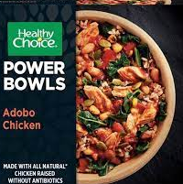
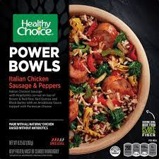
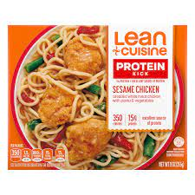
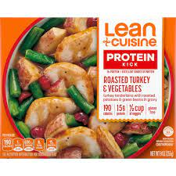
Food Labels: how accurate are they?
Skyler Prosser, David W. Brock Ph.D.
Department of Health and Human Performance, Honors Capstone
Radford University
Introduction
Methods
Conclusions
Nutrition is vital for human health
Cost and lack of time hinder consistent healthy eating habits
Frozen packaged meals address demand largely due to long shelf-life and convenience
Food labels provide nutritional content and can be part of a dietary plan
Separated and weighed each ingredient on electronic scale and recorded
Accurate information presented on labels other than Lean Cuisine Sesame Chicken meal
Background
Results
Nutrition and health claims can affect consumer purchase and consumption
Underutilization of food labels despite their usefulness
Gap in literature regarding frozen meals and frozen food
 | Measured Content | Label Information | P-value
AC: weight | 276 g | 276 g | 0.73
AC: kcal | 331 kcal | 330 kcal | 0.44
IC: weight | 269 g | 262 g | 0.14
IC: kcal | 278 kcal | 270 kcal | 0.14
SC: weight | 264 g | 255 g | 0.11
SC: kcal | 411 kcal | 350 kcal | 0.00
RT: weight | 262 g | 255 g | 0.51
RT: kcal | 195 kcal | 190 kcal | 0.51
Future Directions/Limitations
Future Directions
Buy from the same batch
Keep in freezer for different amounts of time
Put measured weights into food analysis software to see if macronutrients align
Limitations
No access to bomb calorimeter
Relied on package for ratio to get kcal
Used different scales for different brands
Specific Aim
Analyze variability between calories, weight, and individual ingredients
Frozen Meals Used
Acknowledgements
AC = Healthy Choice Adobo Chicken
IC = Healthy Choice Italian Chicken
SC = Lean Cuisine Sesame Chicken
RT = Lean Cuisine Roasted Turkey
Thank you to my mentor, David W. Brock Ph. D., Trisha Sterringer, Radford Honors College, and the Office of Undergraduate Research!

