Slide 1
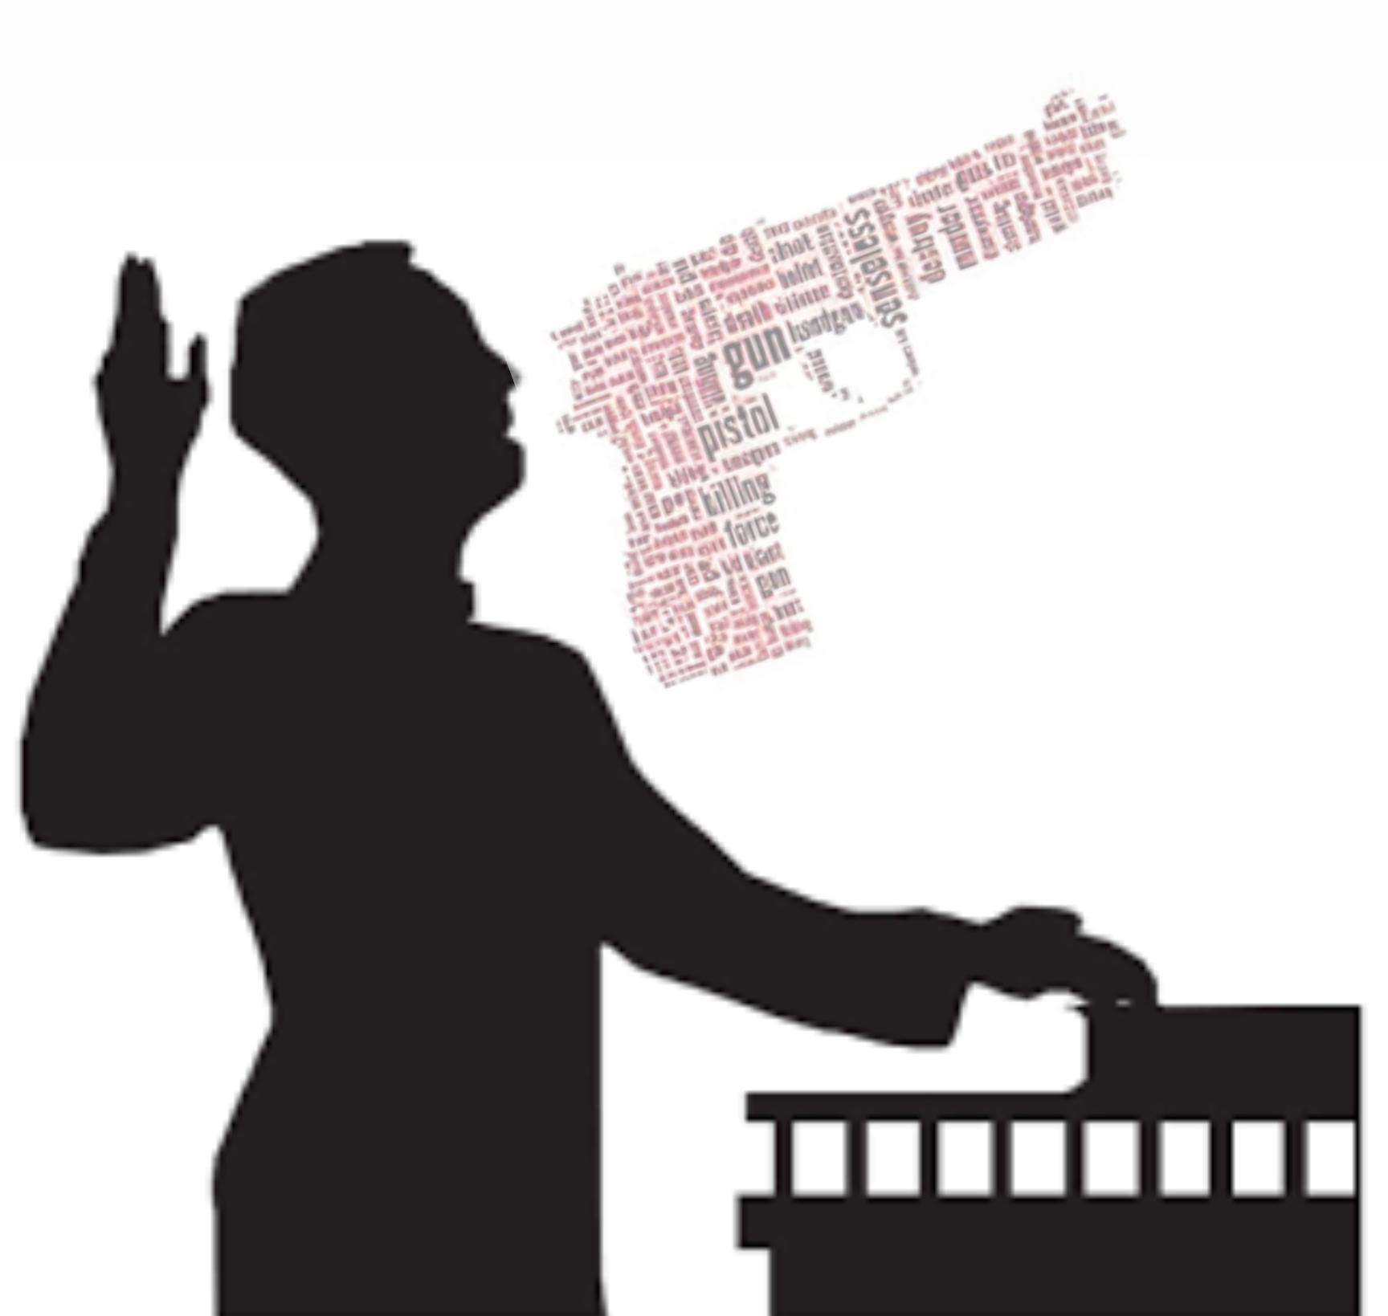
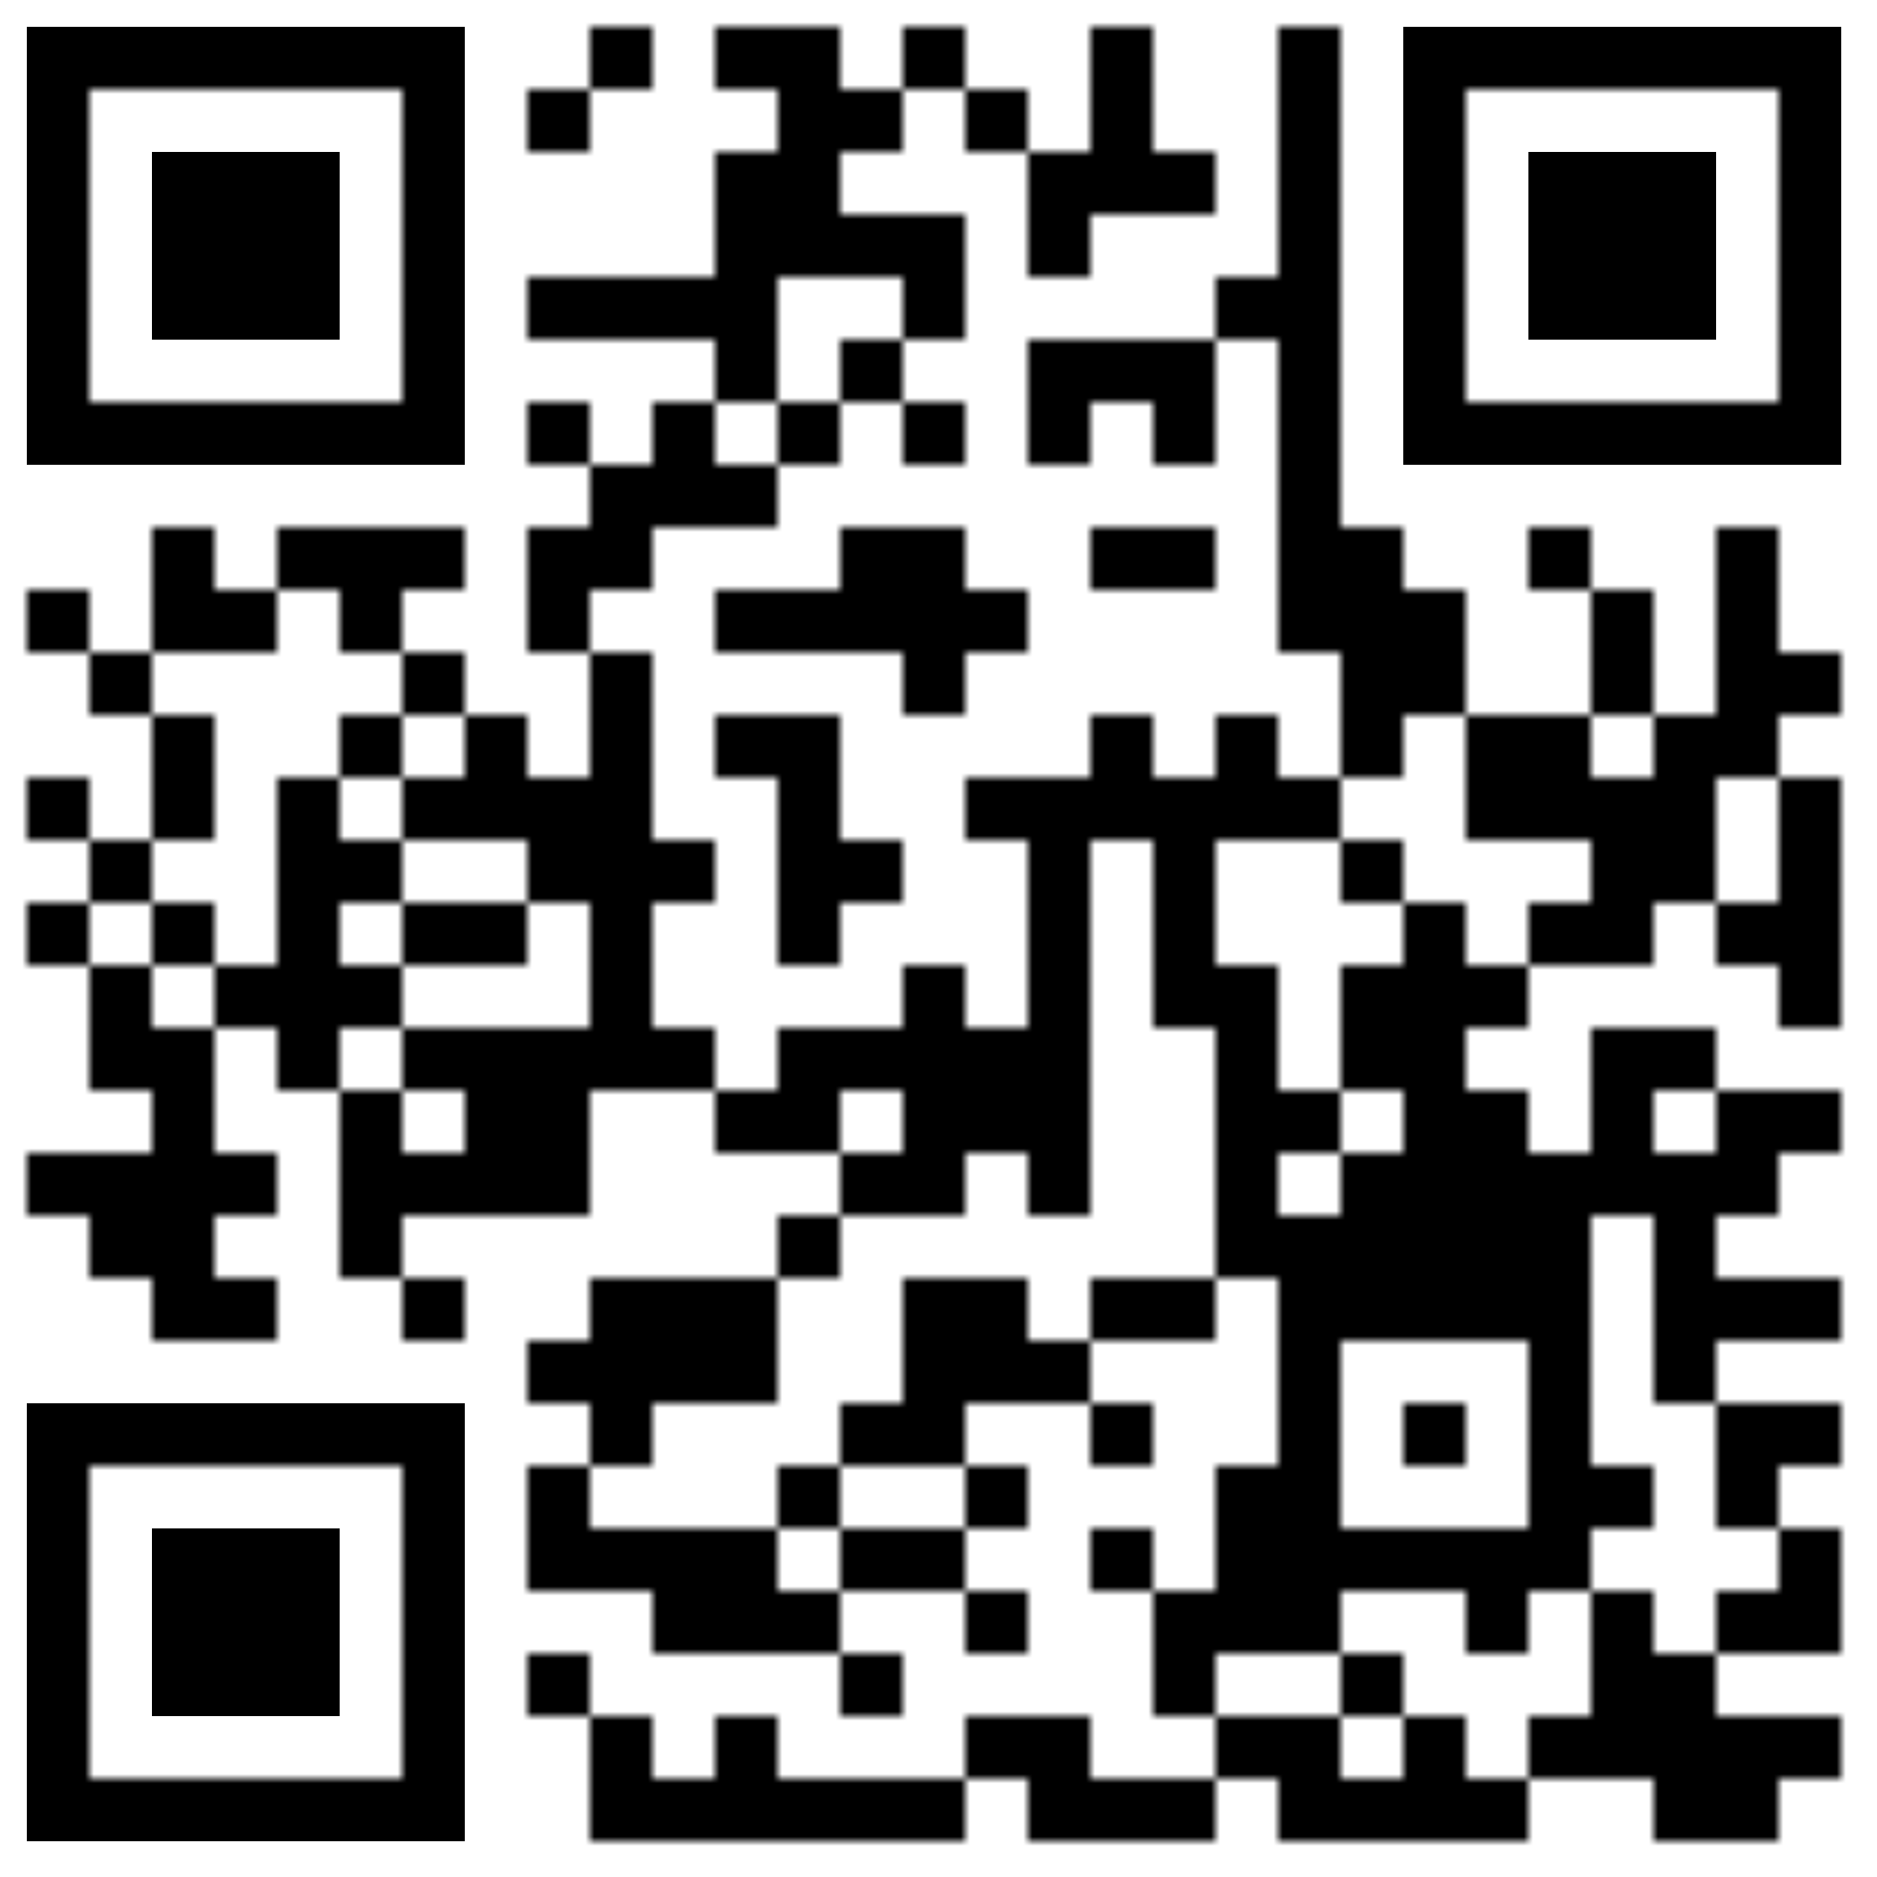
Eyewitness Testimony: Testing the Memory
Will You Incriminate the Innocent?
What? Eyewitness memory consists of both recall and recognition.
Why? Because the ability to recall an event and recognize features existing within the event remain separate, describing a crime and identifying the suspect are exclusive to one another as well.
When? Ronald Cotton was wrongly convicted of a crime he did not commit, subjecting him to spend 10 years in prison.
How? Improper practices when questioning an eyewitness include; asking leading questions, informing the eyewitness of their performance, and allowing an officer investigating the case to conduct the lineup for eyewitness identification.
13% Incriminated the Innocent With Proper Investigation Tactics
29% Saved the Innocent With Proper Investigation Tactics
17% Saved the Innocent With Improper Investigation Tactics
41% Incriminated the Innocent With Improper Investigation Tactics
By EJ Auvil
Become an Eyewitness

